Slide 1
2017-18 FAFSA on the Web Preview Presentation
September 2016

Slide 2
TOPICS
Overview
Home Page
Login
Dependent Student with Parental Data
Independent Student
My FAFSA Pages
Auto-Zero EFC (skipping the remaining financial questions)
Special Circumstances
Special Circumstance – Unsubsidized Loan Only
Homeless Circumstance
Additional Resources

Slide 3
Overview
The 2017-18 FAFSA on the Web (FOTW ®) Preview Presentation provides screenshots that Financial Aid Professionals, mentors, and counselors can use as a guide for the 2017-18 FOTW site. The screenshots and information provided can be used to create/modify presentations for professional trainings and high school nights.
The screenshots are intended to show the majority of the questions displayed on FOTW; however, most students and/or parents are unlikely to need to answer all of the questions when completing his/her application.
This presentation does not include screenshots of the FOTW Correction process, as it is similar to the Application process.
The test data used in this presentation shows examples of what the FOTW site will look like.

Slide 4
Overview (continued)
Please see the red arrows on each slide, or review the notes section of each slide for additional information about the slide.
The 2017-18 version of FOTW will be available for applicants to use on October 1, 2016.
You can use the Web Demonstration site to preview 2017-18 functionality beginning on September 25, 2016.
The 2017-18 FOTW and Web Demonstration sites are pending Office of Management and Budget approval prior to implementation and are subject to change.

Slide 5
Home Page
Notes:
Home Page

Slide 6
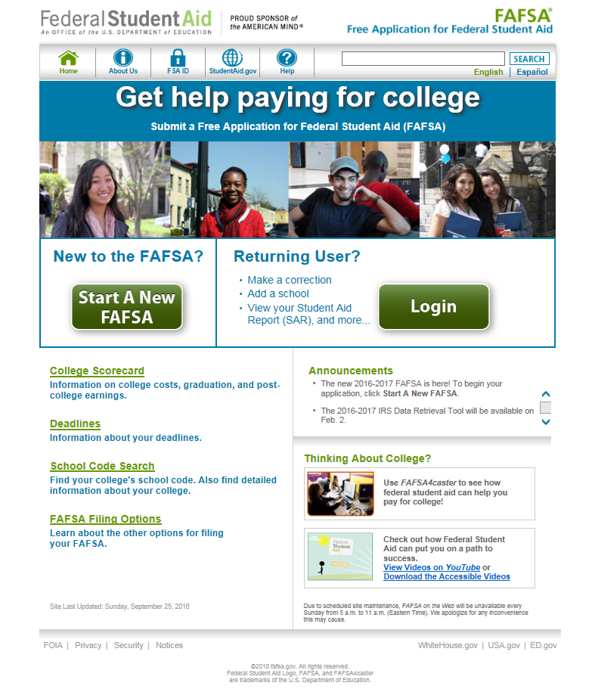
FAFSA Home Page
Notes:
2017-18 FAFSA on the Web home page (www.fafsa.gov).

Slide 7
Login
Notes:
Login

Slide 8
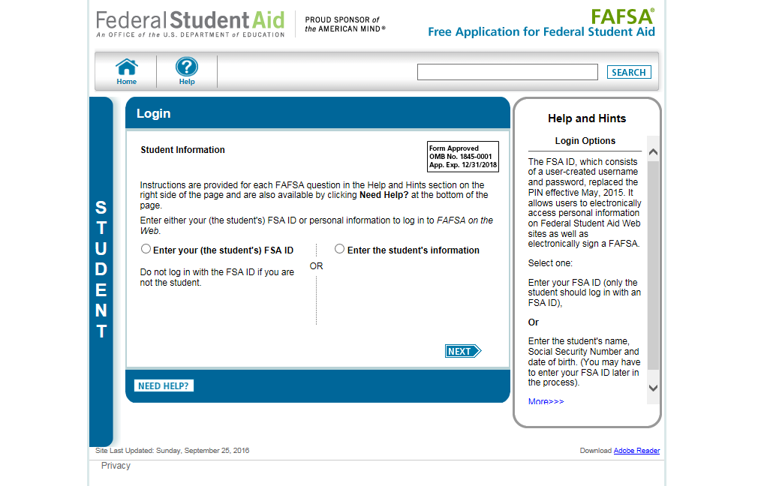
Login (continued)
Notes:
2017-18 “Login” page.

Slide 9
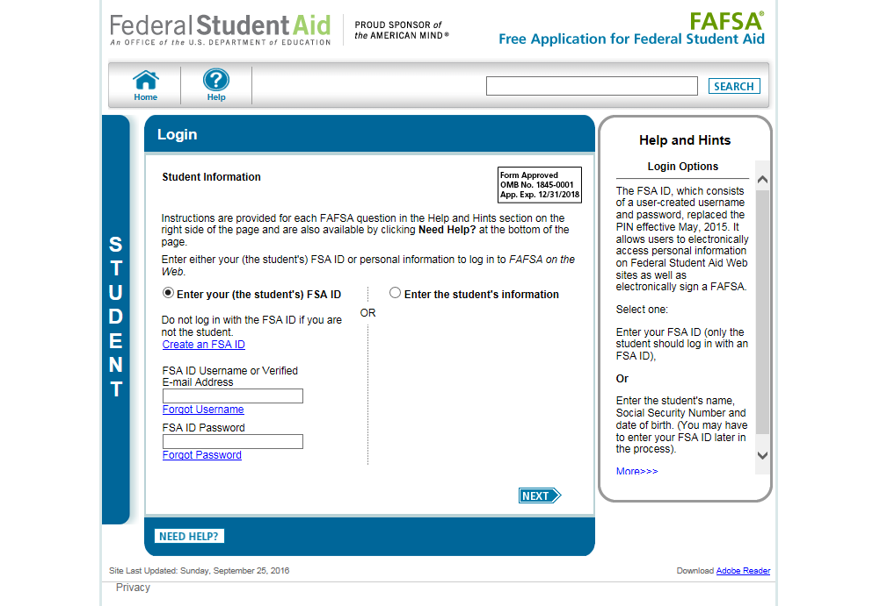
Login with FSA ID
Notes:
2017-18 “Login” page with Enter your FSA ID option selected.
Note: It is beneficial for the student/parent to include an e-mail address on his/her FSA ID account to allow the U.S. Department of Education to communicate directly with the FSA ID owner about the status of his/her account. The e-mail address is entered when the student/parent applies for his/her FSA ID.
Reminder: While the e-mail address for FSA ID is optional, if the user does want to include an e-mail address, it can be used only once with an FSA ID. If users share an e-mail address, only one user may link the e-mail address to an FSA ID.

Slide 10
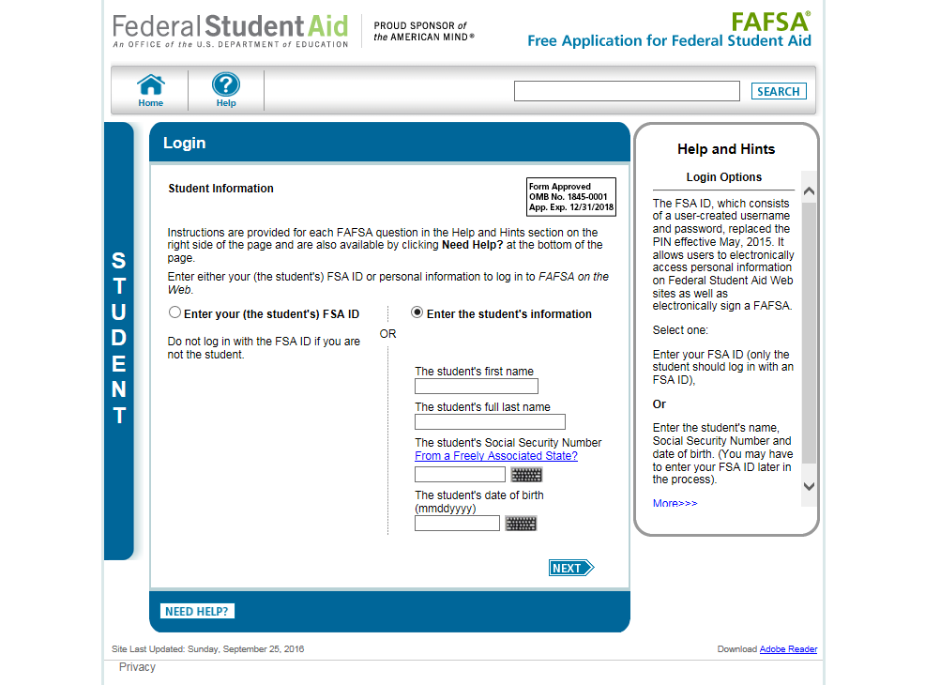
Login with Student Information
Notes:
2017-18 “Login” page with Enter the student’s information option selected.

Slide 11
Dependent Student with Parental Data
Notes:
Dependent Student with Parental Data

Slide 12
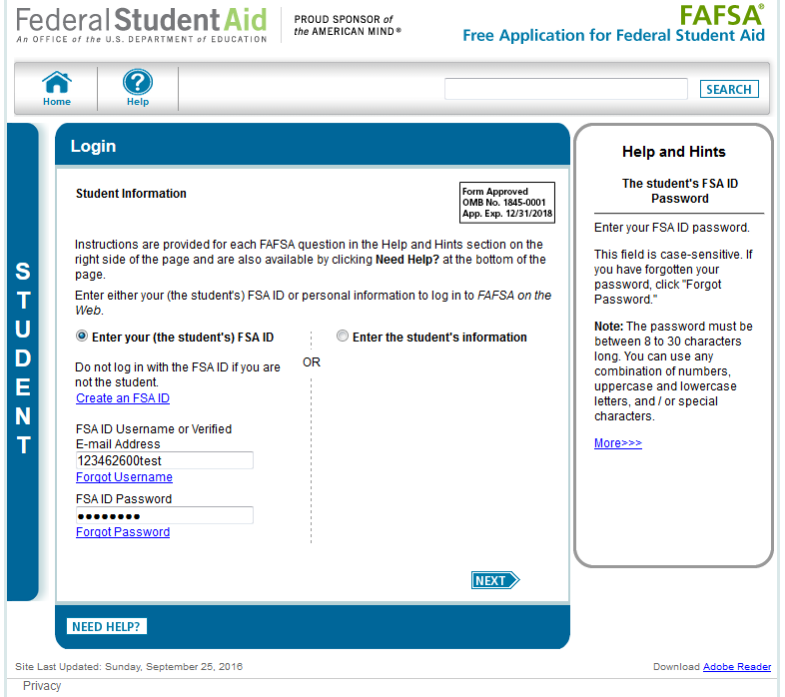
Login with Student Data Entered
Notes:
2017-18 “Login” page with the applicant’s data entered.

Slide 13
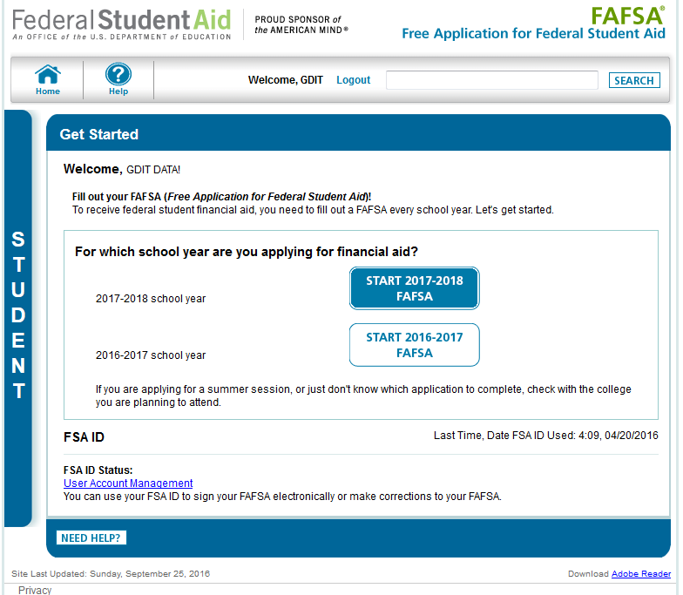
My FAFSA
Notes:
2017-18 “Get Started” page.
This page was revised to provide clarification on which school year the applicant should apply for based on the school year they are planning to attend college.
The applicant can view the status of his/her FSA ID in the FSA ID section of the My FAFSA page.

Slide 14
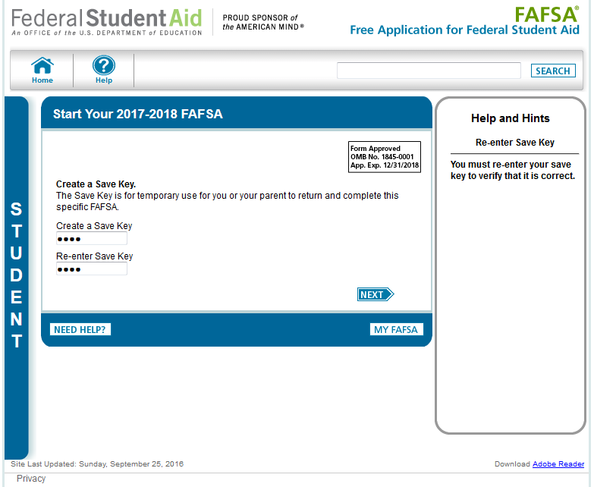
Create a Save Key
Notes:
The “Save Key” allows an applicant to save his/her FAFSA application and return at a later time to complete and submit the application. The application is saved for 45 days or until the student submits his/her application for processing. Additionally, the Save Key allows applicants a way to share their application with their parents.

Slide 15
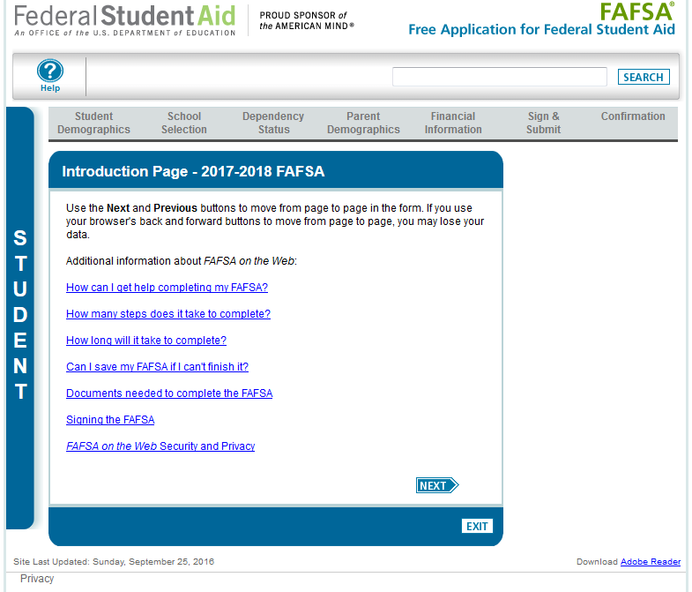
Introduction
Notes:
2017-18 “Introduction Page”.

Slide 16
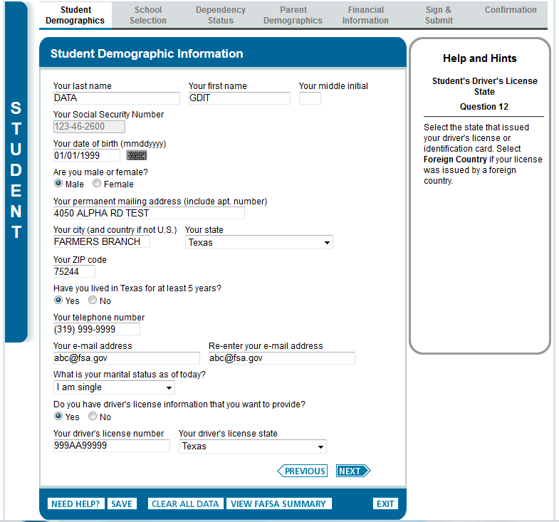
Student Demographic Information
Notes:
2017-18 “Student Demographic Information” page.

Slide 17
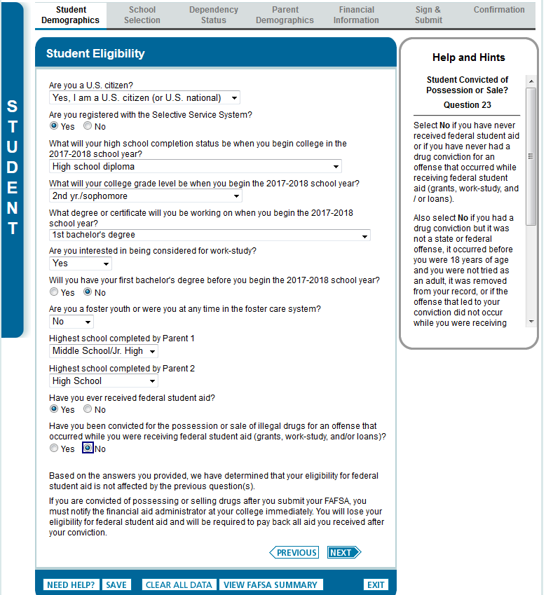
Student Eligibility
Notes:
2017-18 “Student Eligibility” page.
The word “college” was added to the question “What will your college grade level be when you begin the 2017-18 school year?”

Slide 18
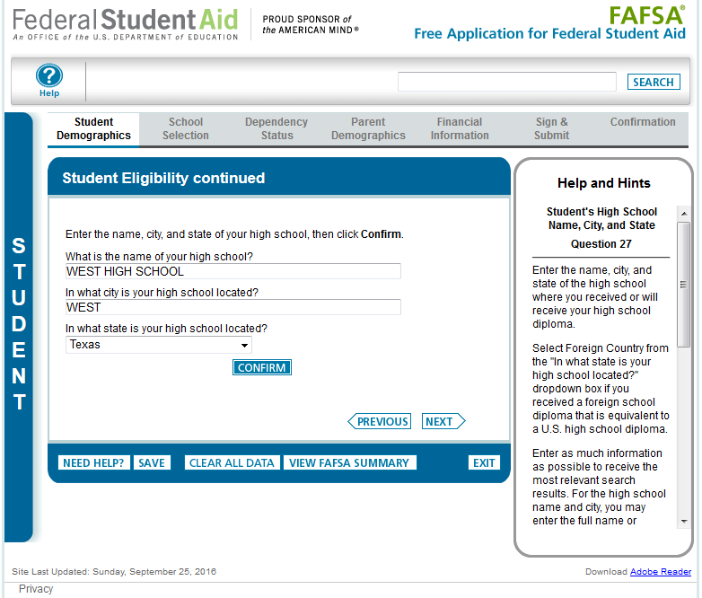
Student Eligibility/High School Search
Notes:
2017-18 “Student Eligibility continued” page.

Slide 19
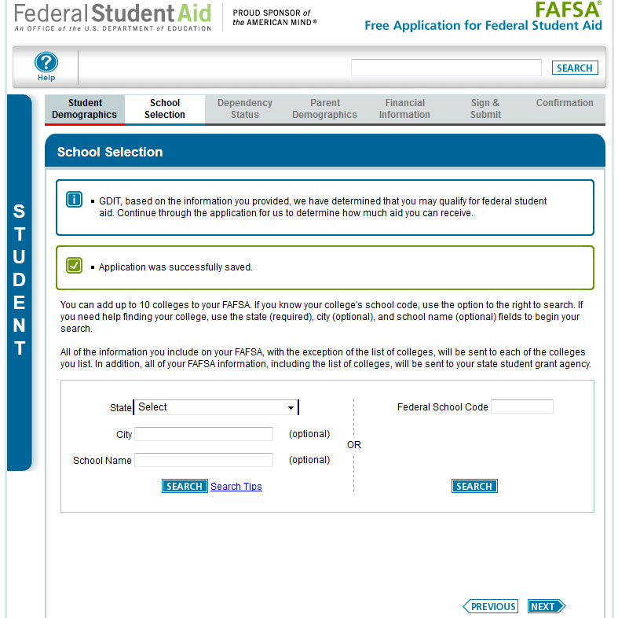
School Selection
Notes:
“School Selection” page.

Slide 20
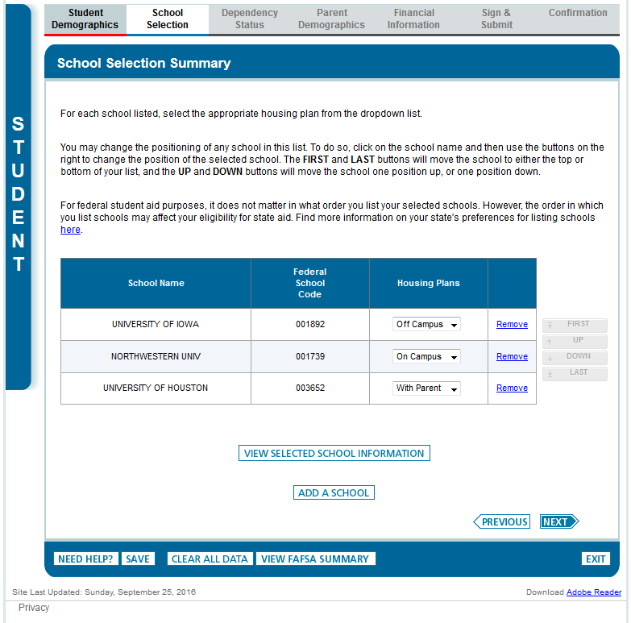
School Selection Summary
Notes:
2017-18 “School Selection Summary” page.

Slide 21
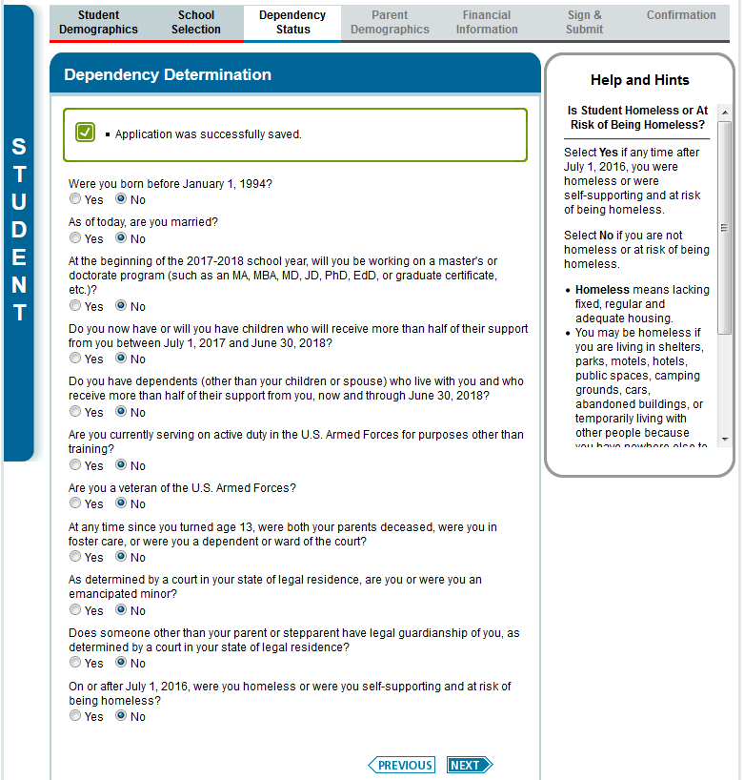
Dependency Determination
Notes:
2017-18 “Dependency Determination” page.

Slide 22
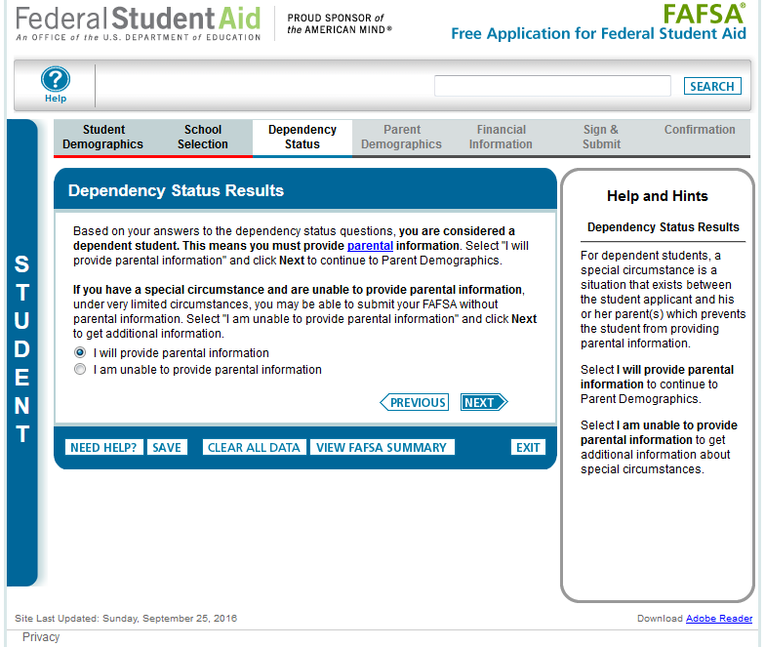
Dependency Status Results
Notes:
2017-18 “Dependency Status Results” page.
This page only displays if the applicant has been determined to be dependent.

Slide 23
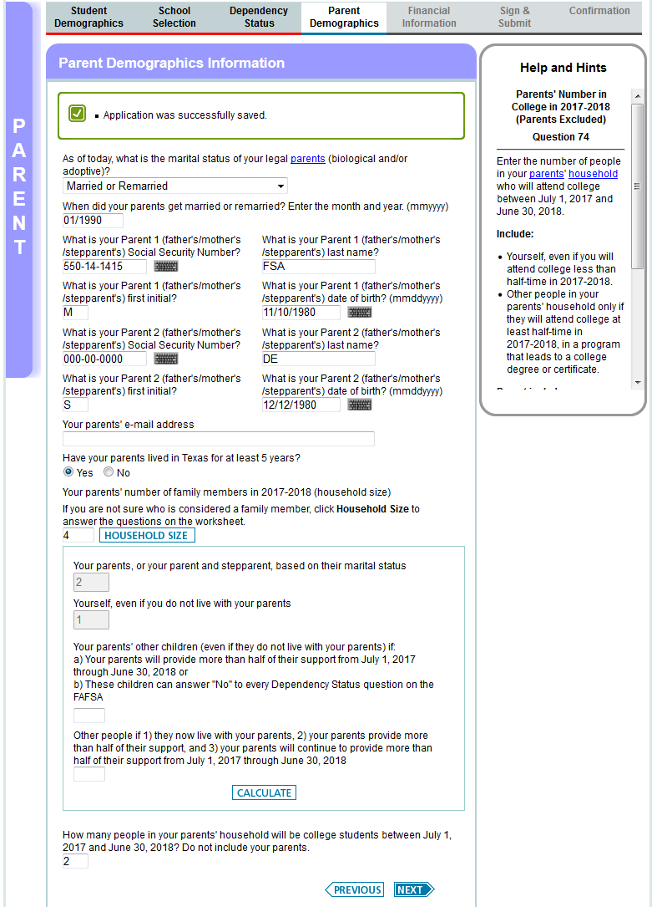
Parent Demographics
Notes:
2017-18 “Parent Demographic Information” page.

Slide 24
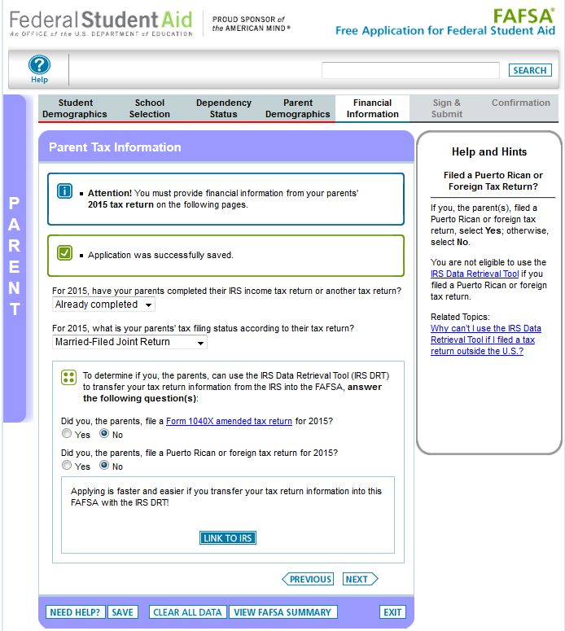
Parent Tax Information
Notes:
2017-18 “Parent Tax Information” page.
New for 2017-18, the 2015 tax information will be requested instead of the 2016 tax information. To emphasize this change for students and parents, an alert message will display indicating “Attention! You must provide financial information from your parents’ 2015 tax return on the following pages.”
Additionally, the IRS Data Retrieval Tool (DRT) section of the application has been revised to make the following changes:
The “Did you, the parents, file taxes electronically in the last 3 weeks (or by mail in the last 11 weeks)?” question has been removed.
Parents will not be requested to provide their FSA ID (if not already provided) on the “Parent Tax Information” page prior to clicking “Link to IRS”
The Amended Tax Return and Foreign Tax Return questions have been revised to include 2015 as part of the question.
The definition of the 1040 X amended tax return can be found by following the link that was added to the question.

Slide 25
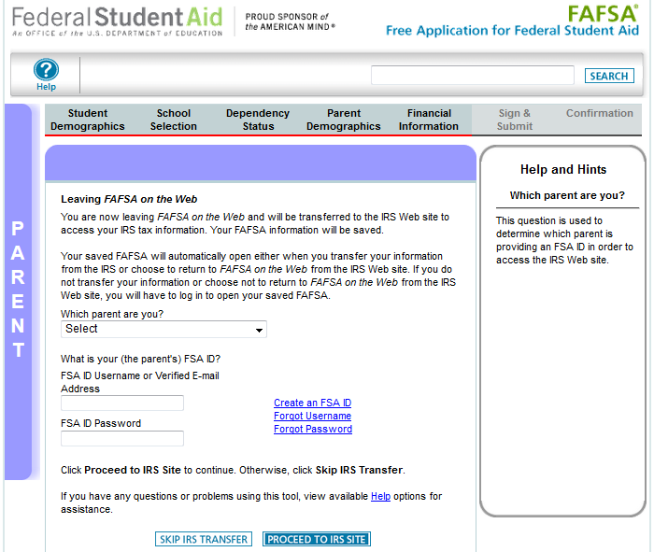
Parent Tax Information (continued)
Notes:
2017-18 “Leaving FAFSA on the Web” page.
The “Leaving FAFSA on the Web” page has been revised to provide information on how to utilize the IRS DRT and what will occur if they opt to not use the IRS DRT. This page has been revised to request the parent’s FSA ID to access the IRS DRT.

Slide 26
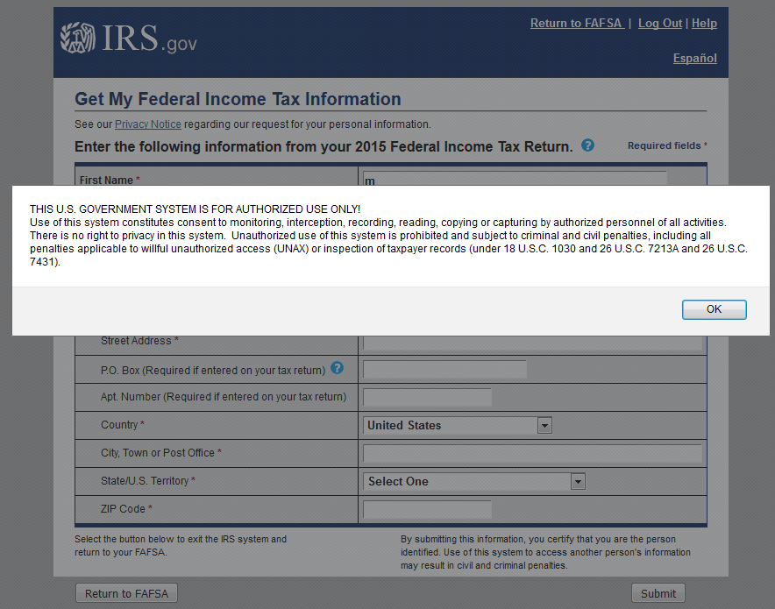
IRS Data Retrieval Tool (DRT)
Notes:
Warning text appears as the 2017-18 IRS DRT site is displayed.

Slide 27
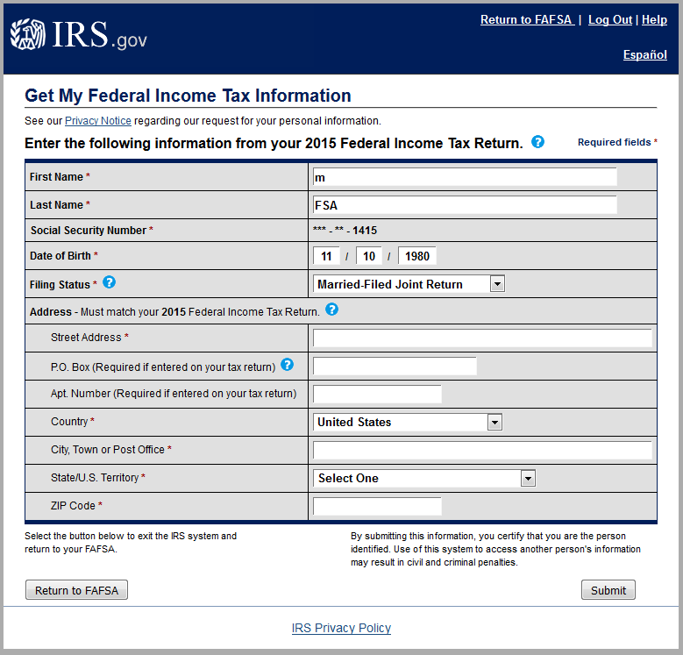
IRS DRT (Parent) with User Information
These fields are pre-filled based on FAFSA responses
Notes:
2017-18 IRS Data Retrieval Tool, page 1, containing user demographic information.
Even though the fields at the top are pre-filled based on FAFSA responses, the first name, last name, date of birth, and the filing status can be updated on this page. The Social Security Number cannot be updated.

Slide 28
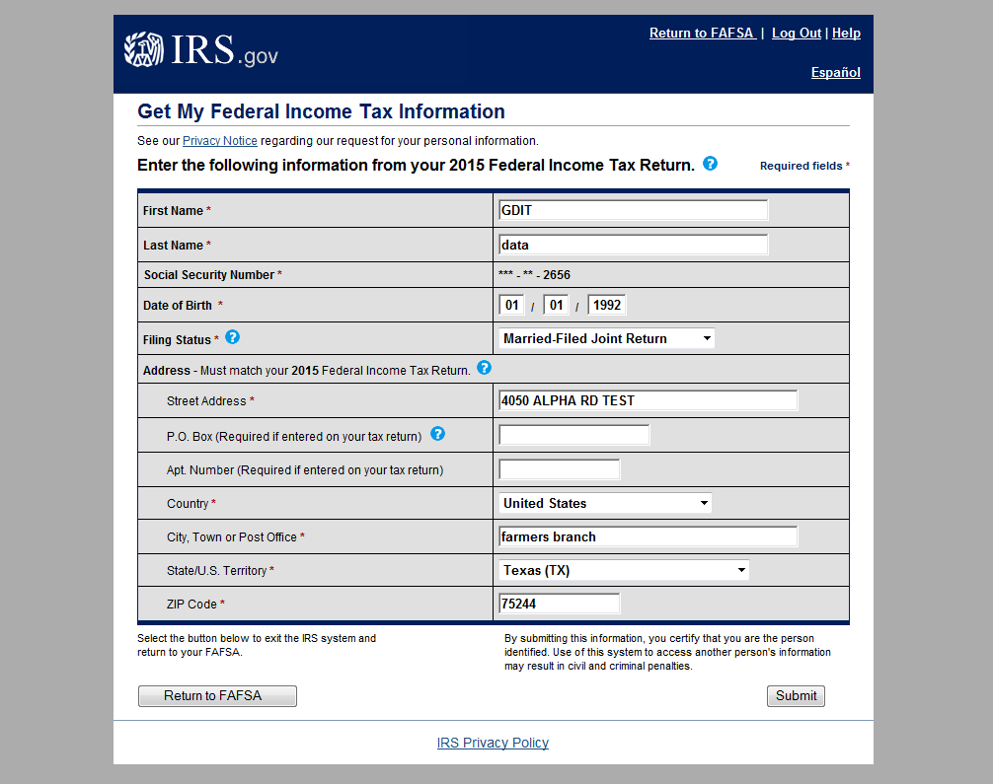
IRS DRT (Parent) Submit and Return Options
Notes:
2017-18 IRS Data Retrieval Tool, page 1, containing user demographic information (continued, updated with user information). The user can click “Submit” to retrieve IRS data, or “Return to FAFSA” to discontinue use of the IRS DRT and return to FOTW.

Slide 29
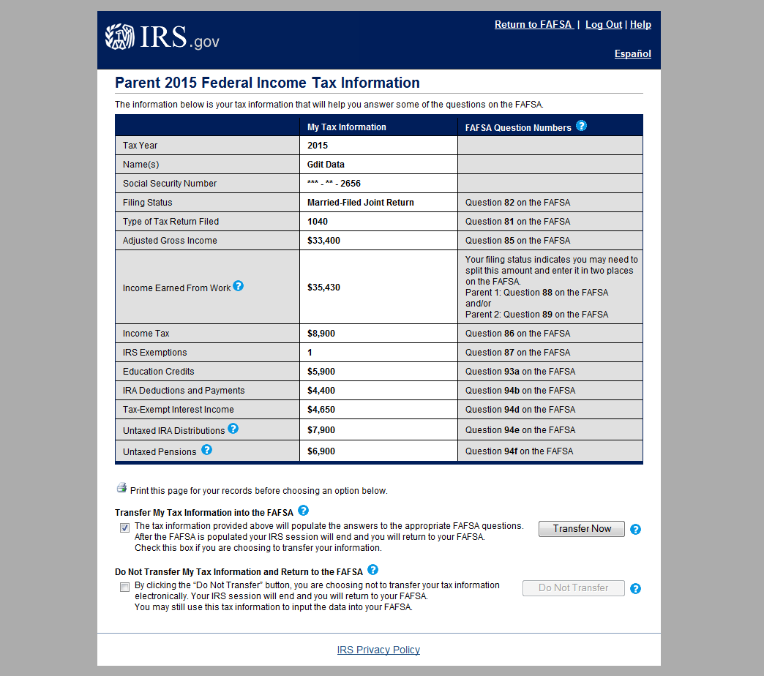
IRS DRT (Parent) Data Transfer Options
Notes:
2017-18 IRS Data Retrieval Tool, page 2, containing user-specific IRS data.
The user can check the “Transfer My Tax Information…” box and click “Transfer Now” to carry this data back into FOTW.
The user can check the “Do Not Transfer…” box and click “Do Not Transfer” to discontinue use of the IRS DRT and return to FOTW.
The user can click the “Print this page” icon in order to print the data that is displayed on this page.

Slide 30
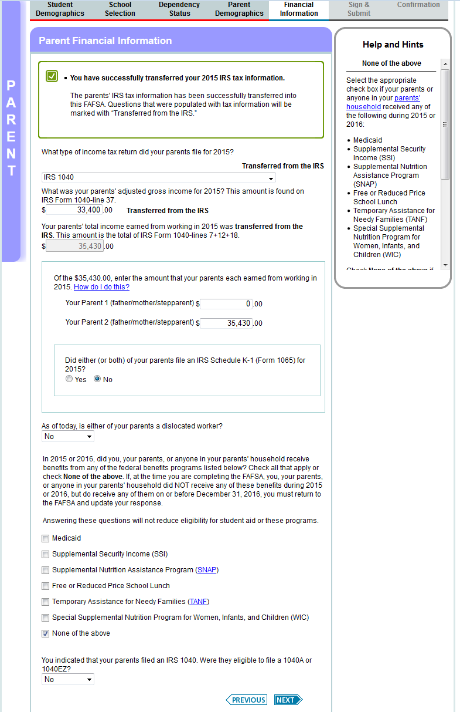
Parent Financial Information
Notes:
2017-18 “Parent Financial Information” page.
“Medicaid” has been added as an option under the Federal Means Tested Benefits. On all output documents, this will be listed as part of the Supplemental Security Income (SSI) response.
“School” has been added as part of the “Free or Reduced Price School Lunch” question.

Slide 31
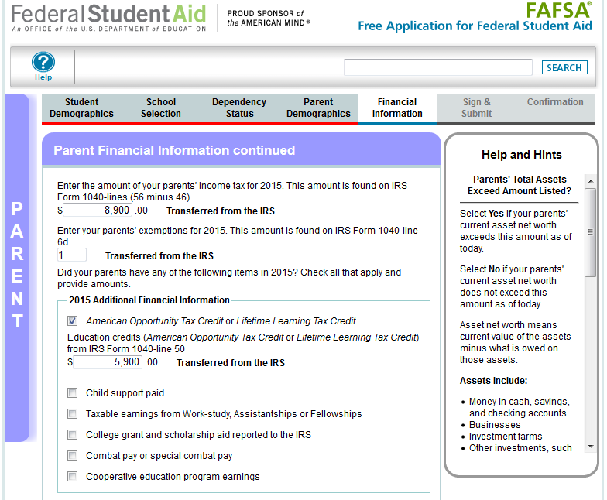
Parent Financial Information (continued)
Notes:
This is the top half of the 2017-18 “Parent Financial Information continued” page. The bottom half of the page is continued on the next slide.
The “Additional Financial Information” section was updated to include “2015” for clarity.

Slide 32
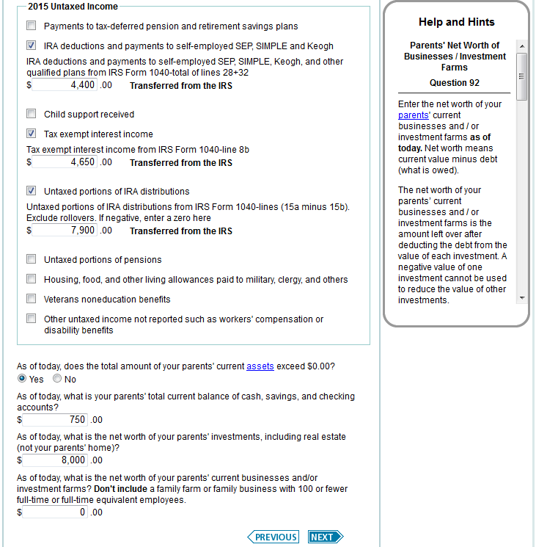
Parent Financial Information (continued) – Text Change
Notes:
This is the bottom half of the 2017-18 “Parent Financial Information continued” page.
The “Untaxed Income” section was updated to include “2015” for clarity.

Slide 33
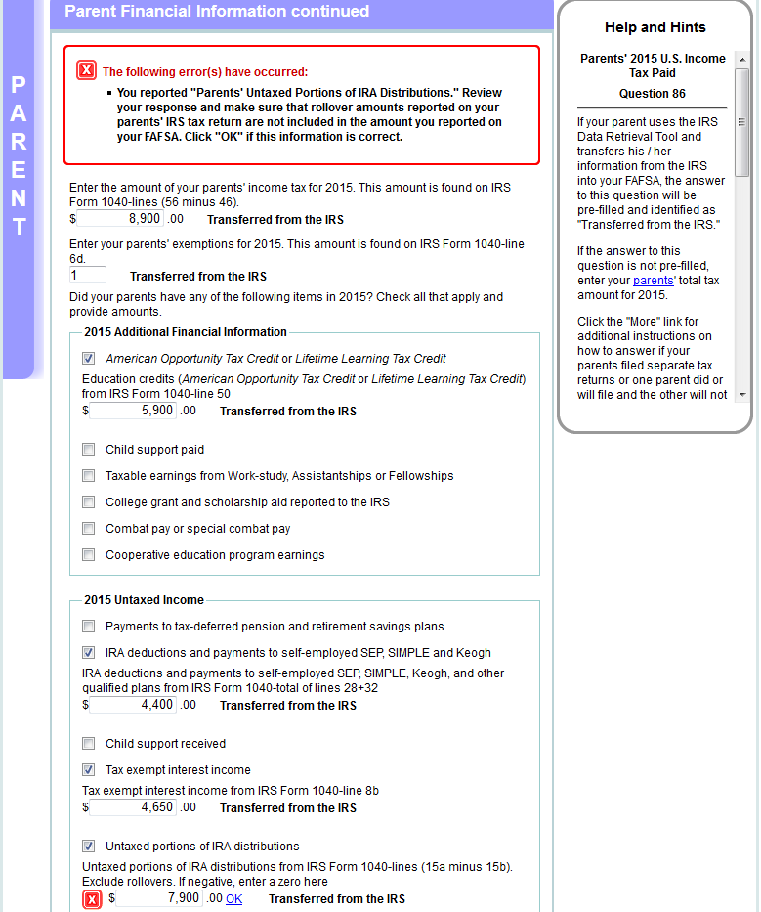
Parent Financial Information (continued) – Tax information verification
Notes:
This is the bottom half of the 2017-18 “Parent Financial Information continued” page.

Slide 34
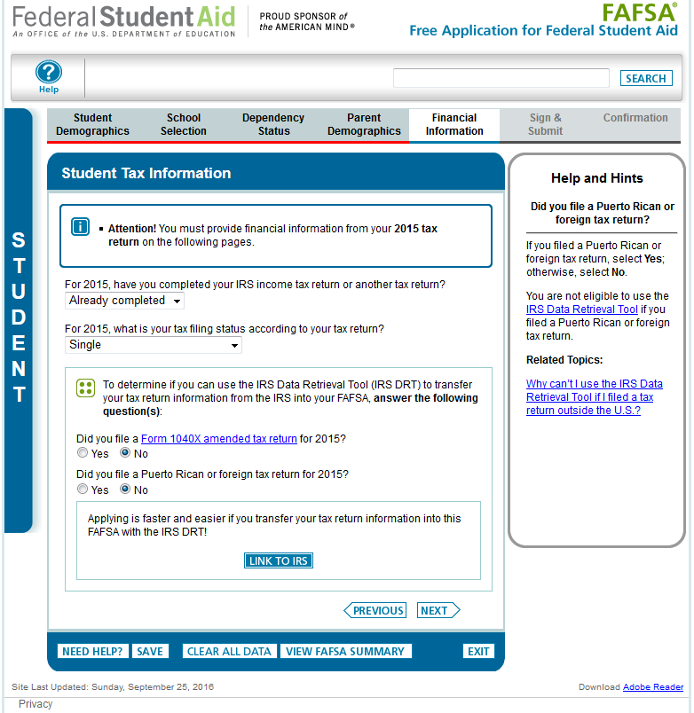
Independent Student, Student Tax Information
Notes:
2017-18 “Student Tax information” page.
New for 2017-18, the 2015 tax information will be requested instead of the 2016 tax information. To emphasize this change for students and parents, an alert message will display indicating “Attention! You must provide financial information from your 2015 tax return on the following pages.”
Additionally, the IRS DRT section of the application has been revised to make the following changes:
The “Did you file taxes electronically in the last 3 weeks (or by mail in the last 11 weeks)?” question has been removed.
Students will not be requested to provide their FSA ID (if not already provided) on the Student Tax Information page prior to clicking “Link to IRS”
The student should click “Link to IRS” rather than “Next” on this page.
The Amended Tax Return and Foreign Tax Return questions have been revised to include 2015 as part of the question.
The definition of the 1040 X amended tax return can be found by following the link that was added to the question.

Slide 35
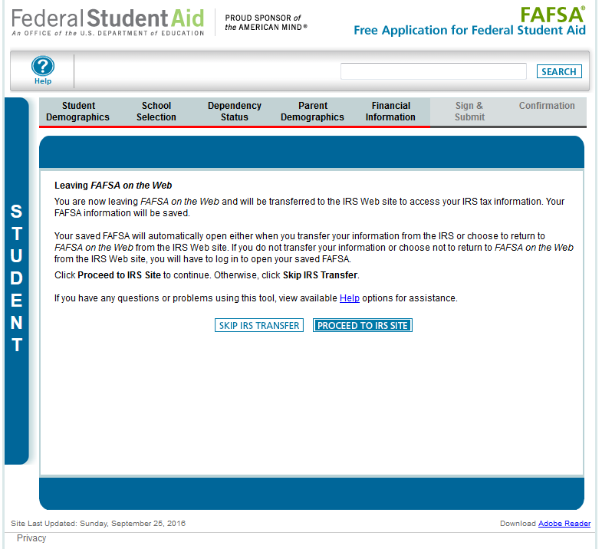
Independent Student, Leaving FAFSA on the Web
Notes:
2017-18 “Leaving FAFSA on the Web” page, displayed when the student is going to the IRS Web site.
The “Leaving FAFSA on the Web” page has been revised to provide information on how to utilize the IRS DRT and what will occur if they opt to not use the IRS DRT.
In this case, the FSA ID for the student was entered when logging into their FAFSA, so it is not requested on this page.

Slide 36
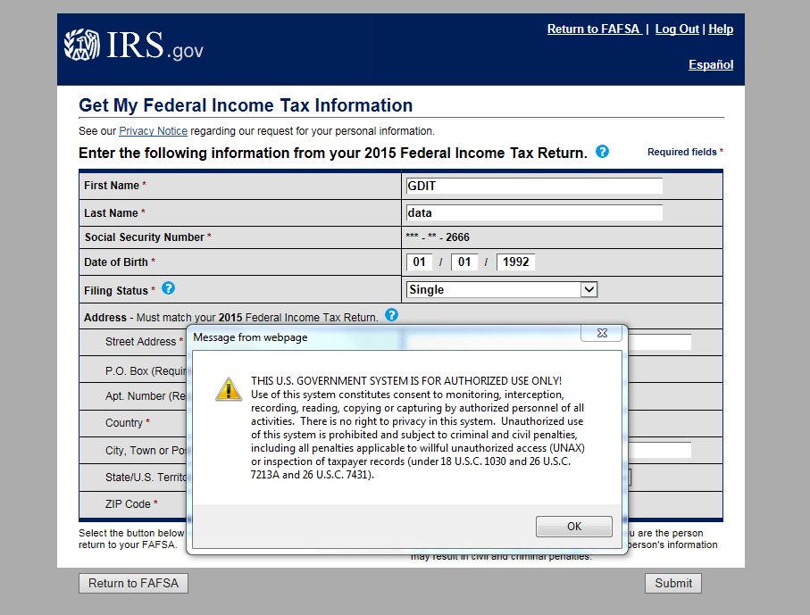
Independent Student, IRS DRT
Notes:
Warning text appears as the 2017-18 IRS DRT site is displayed.

Slide 37
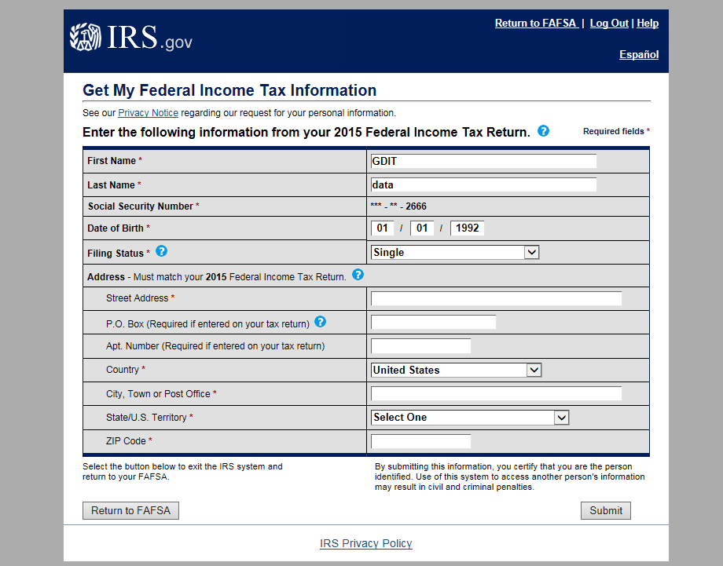
Independent Student, IRS DRT with user information
These fields are pre-filled based on FAFSA responses
Notes:
2017-18 IRS Data Retrieval Tool, page 1, containing user demographic information.
Even though the fields at the top are pre-filled based on FAFSA responses, the first name, last name, date of birth and the filing status can be updated on this page. The Social Security Number cannot be updated.

Slide 38
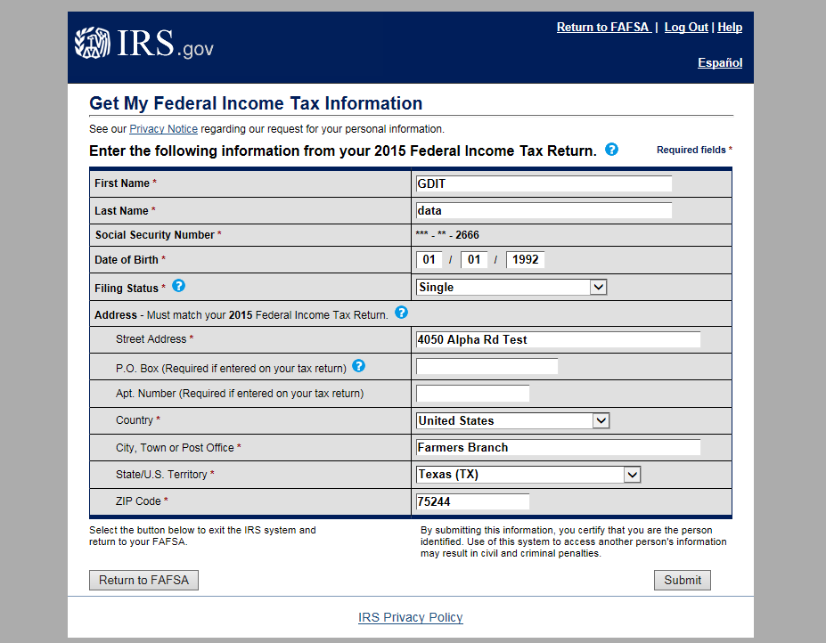
Independent Student, IRS DRT Submit and Return Options
Notes:
2017-18 IRS Data Retrieval Tool, page 1, containing user demographic information (continued, updated with user information). The user can click “Submit” to retrieve IRS data, or “Return to FAFSA” to discontinue use of the IRS DRT and return to FOTW.

Slide 39
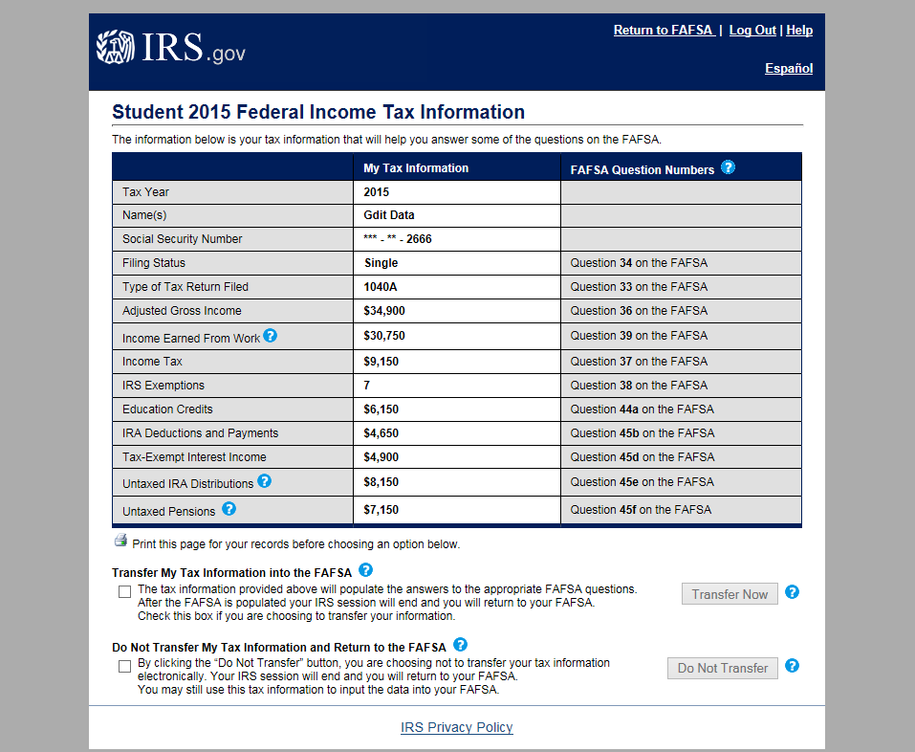
Independent Student, IRS DRT Transfer Options
Notes:
2017-18 IRS Data Retrieval Tool, page 2, containing user-specific IRS data.
The user can check the “Transfer My Tax Information…” box and click “Transfer Now” to carry this data back into FOTW.
The user can check the “Do Not Transfer…” box and click “Do Not Transfer” to discontinue use of the IRS DRT and return to FOTW.
The user can click the “Print this page” icon in order to print the data that is displayed on this page.

Slide 40
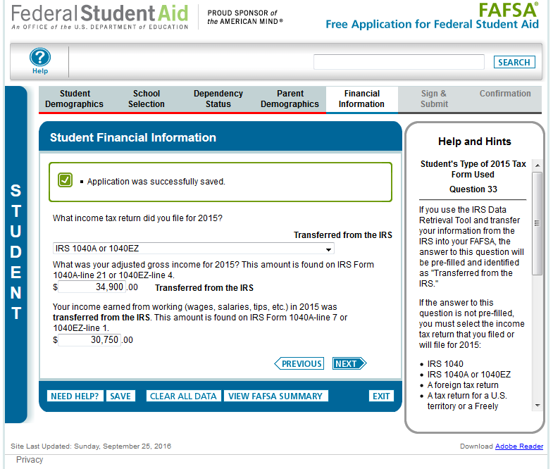
Independent Student, Student Financial Information
Notes:
2017-18 “Student Financial Information” page.

Slide 41
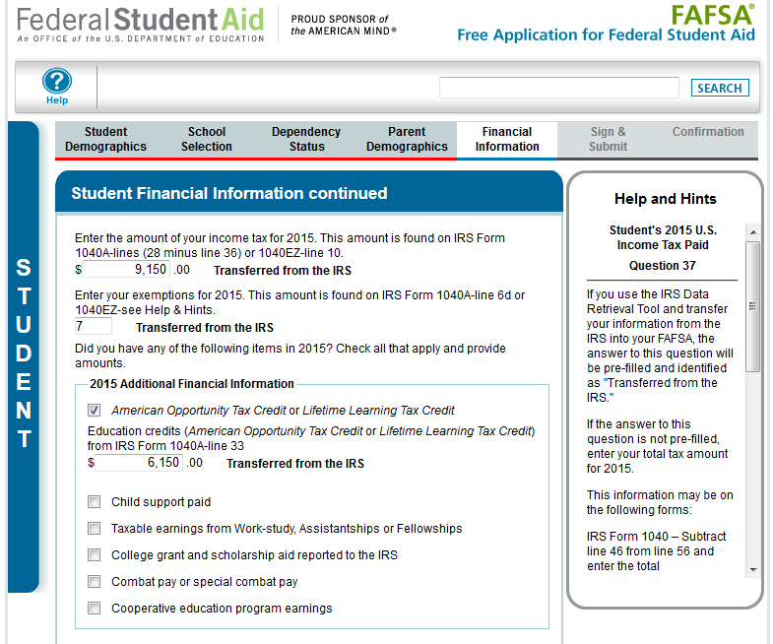
Independent Student, Student Financial Information (continued)
Notes:
Top half of the 2017-18 “Student Financial Information continued” page. Bottom half of the page is continued on the next slide.
The “Additional Financial Information” section was updated to include “2015” for clarity.

Slide 42
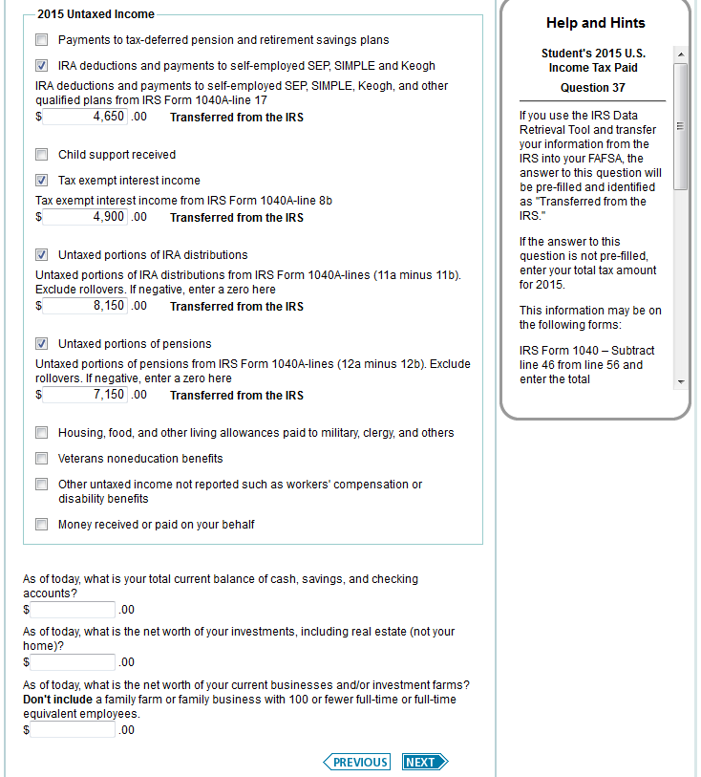
Independent Student, Student Financial Information Text Changes
Notes:
This is the bottom half of the 2017-18 “Student Financial Information continued” page.

Slide 43
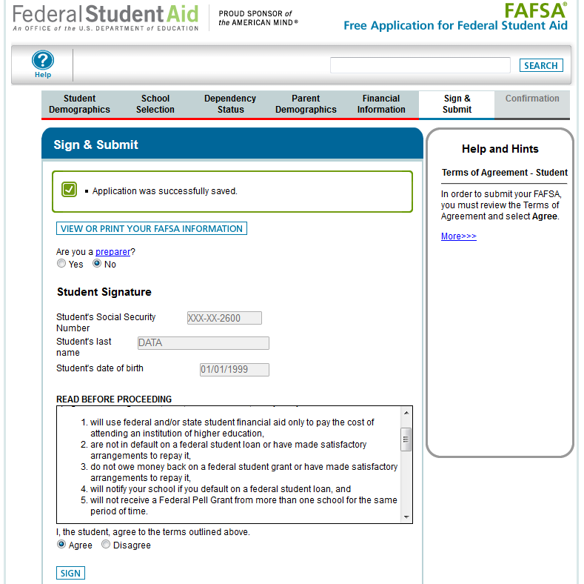
Sign and Submit
Notes:
This is the top half of the 2017-18 “Sign & Submit” page, where the student signs and actively acknowledges the Certification Statement. Applicants must still actively agree with the certification statement.
Since the student entered his/her FSA ID to go to the IRS to transfers data, he/she is not requested to provide his/her FSA ID Username and Password again to sign the application.

Slide 44
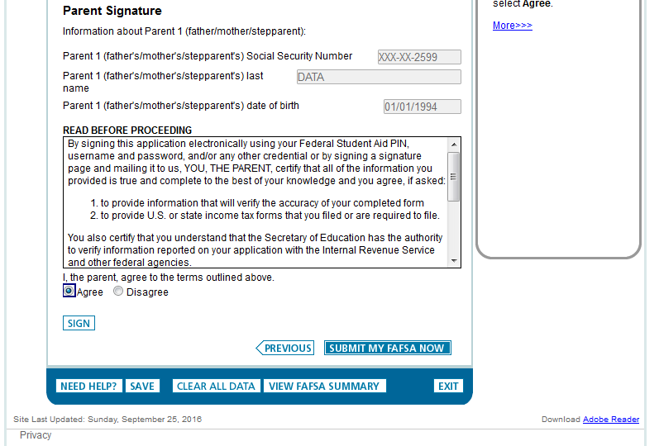
Sign and Submit, Parent Signature
Notes:
This is the bottom half of the 2017-18 “Sign & Submit” page for the dependent student, with the parent signature options and the active confirmation for the parent Certification Statement.
Since the student entered his/her FSA ID to go to the IRS to transfer data, he/she is not requested to provide his/her FSA ID Username and Password again to sign the application.

Slide 45
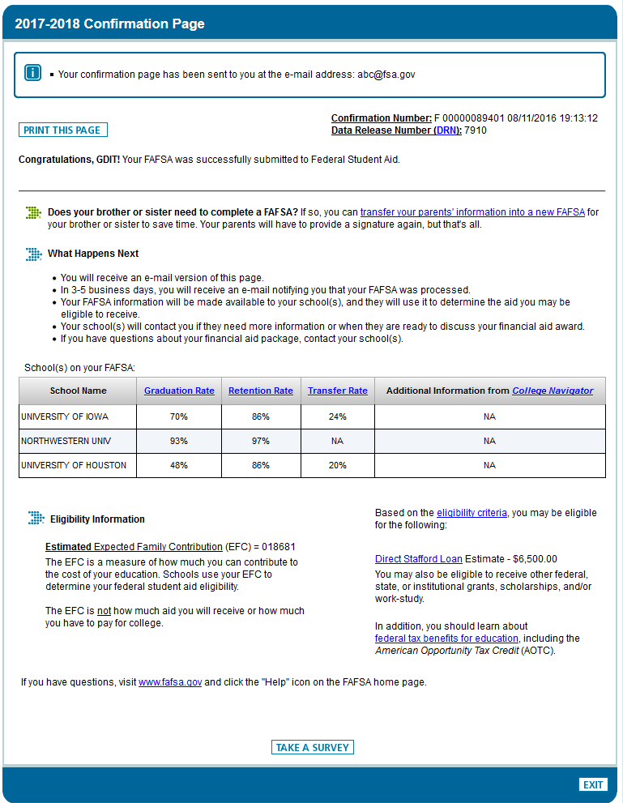
Confirmation Page
Notes:
2017-18 “Confirmation Page”
Parents of dependent students are offered the option to transfer the parents’ data into another student’s new FAFSA. The link is found on the “Confirmation Page.”
If the applicant leaves the confirmation page before they click this link they will not be able to return to transfer data to the application of a sibling.

Slide 46
Independent Student

Slide 47
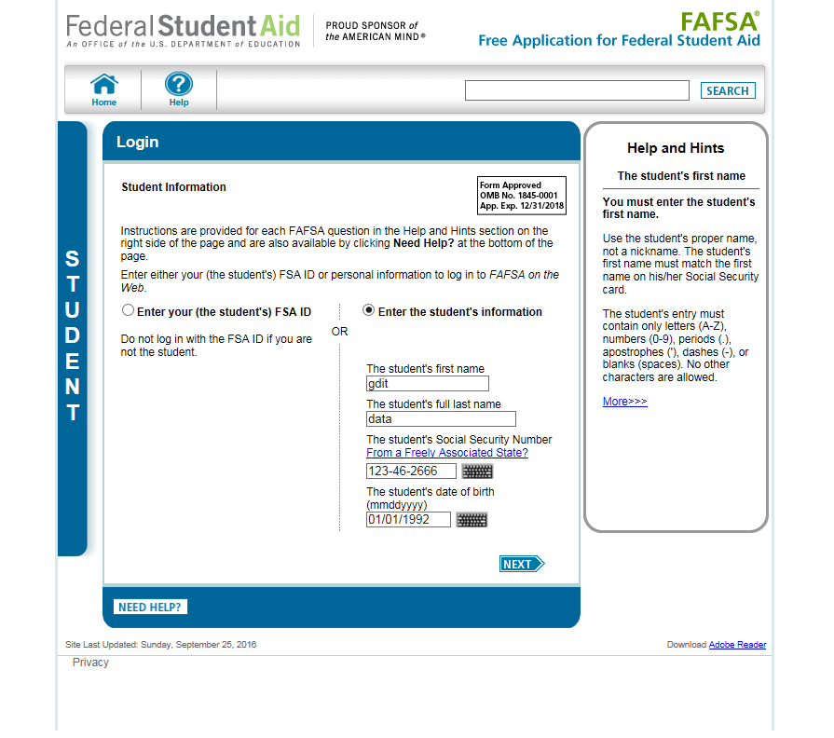
Login with Student Data Entered (continued)
Notes:
2017-18 “Login” page with the applicant’s data entered.

Slide 48
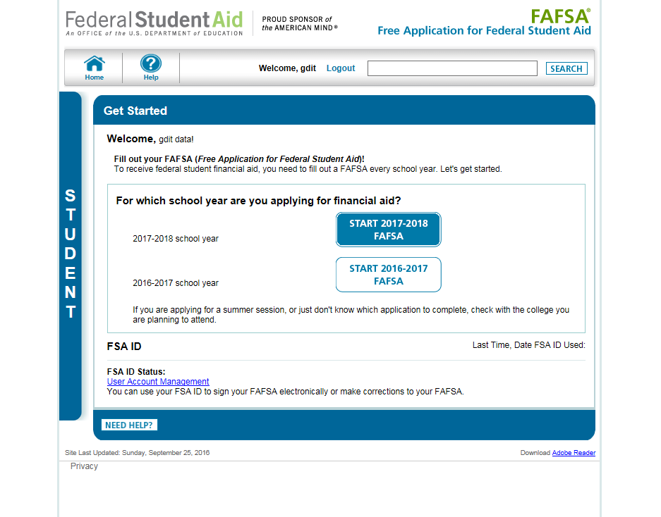
My FAFSA (continued)
Notes:
2017-18 “Get Started” page.
This page was revised to provide clarification on which school year the applicant should apply for based on the school year they are planning to attend college.
The applicant can view the status of his/her FSA ID in the FSA ID section of the My FAFSA page.

Slide 49
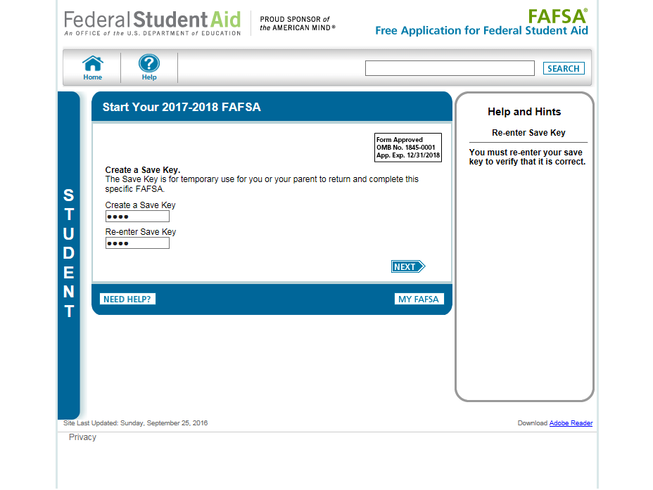
Create a Save Key (Student)
Notes:
The “Save Key” allows an applicant to save his/her FAFSA application and return at a later time to complete and submit the application. The application is saved for 45 days or until the student submits his/her application for processing.

Slide 50
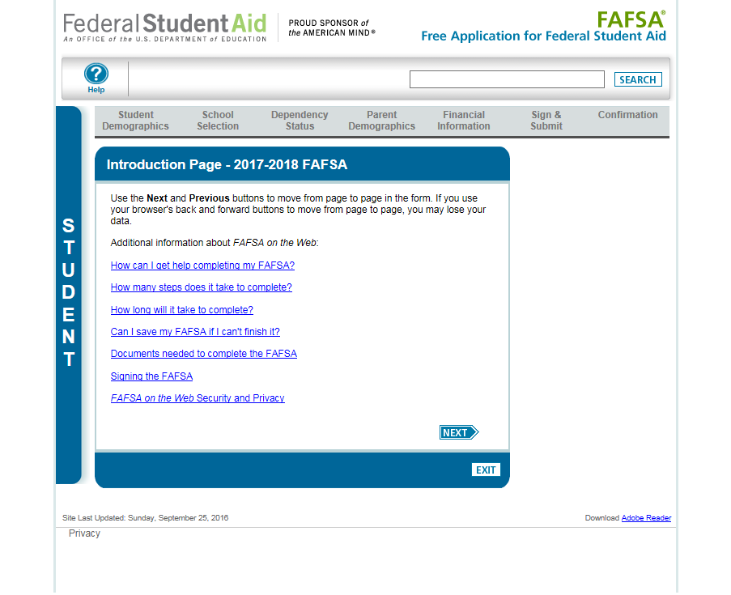
Introduction Page (Student)
Notes:
2017-18 “Introduction Page”.

Slide 51
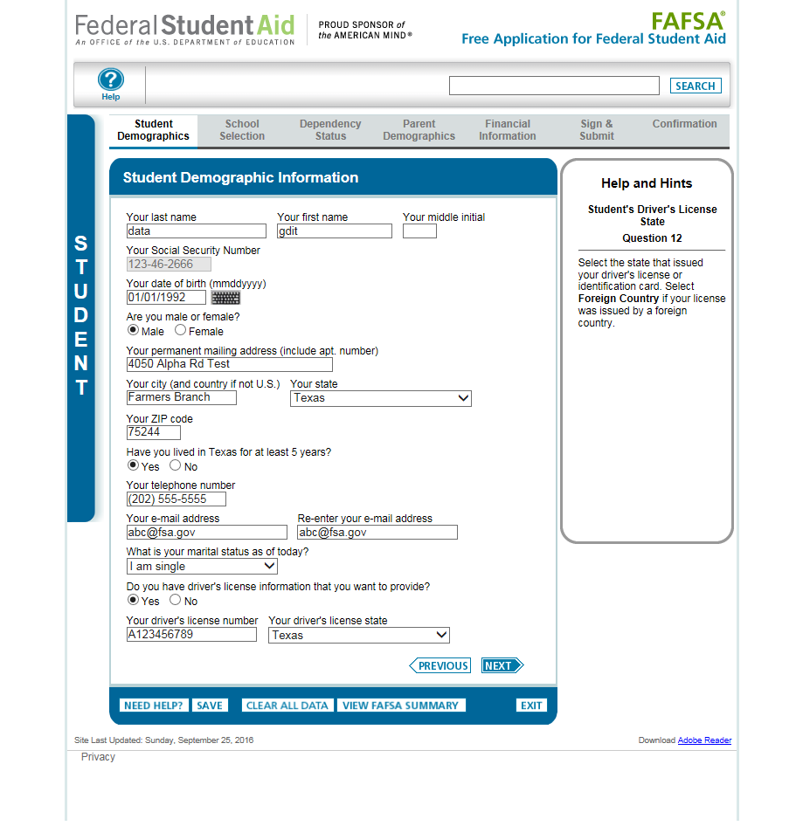
Student Demographic Information (Independent)
Notes:
2017-18 “Student Demographic Information” page.

Slide 52
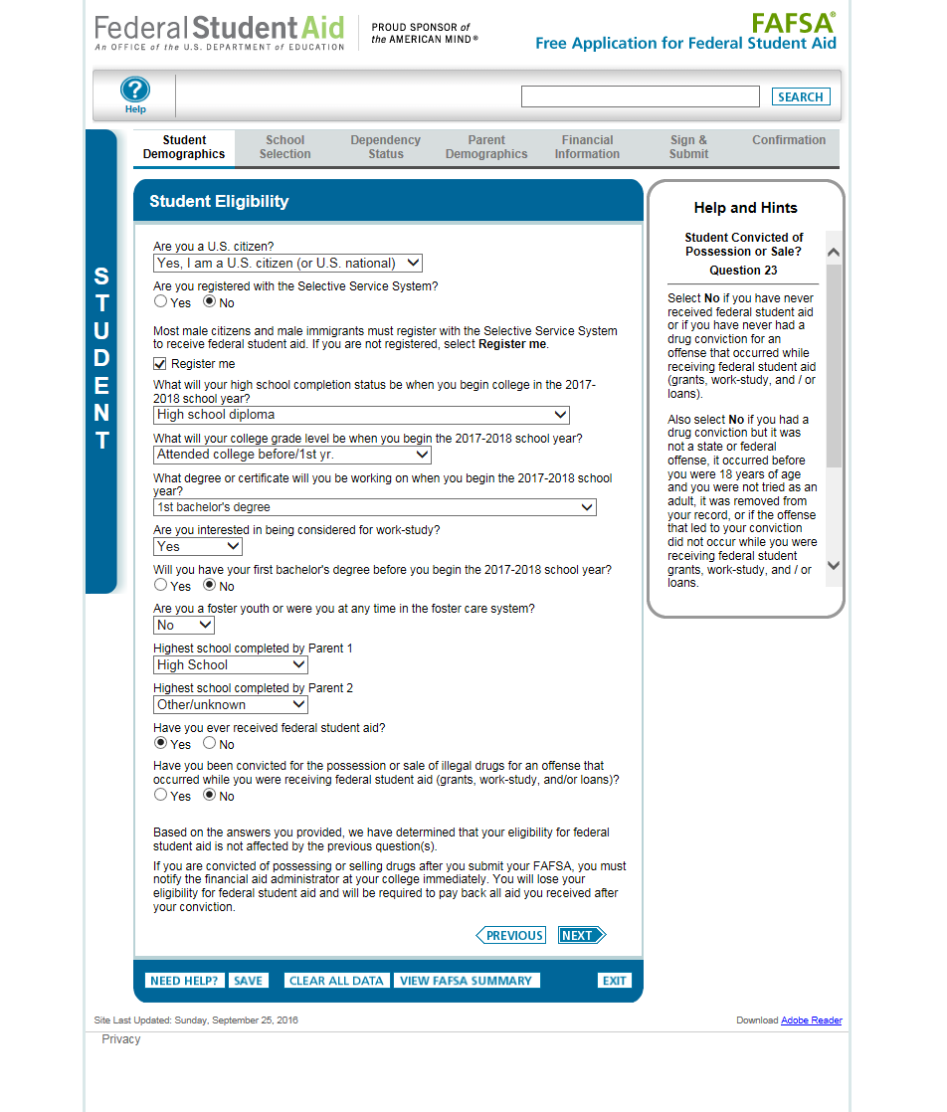
Student Eligibility (Independent)
Notes:
2017-18 “Student Eligibility” page.
The word “college” was added to the question “What will your college grade level be when you begin the 2017-2018 school year?”

Slide 53
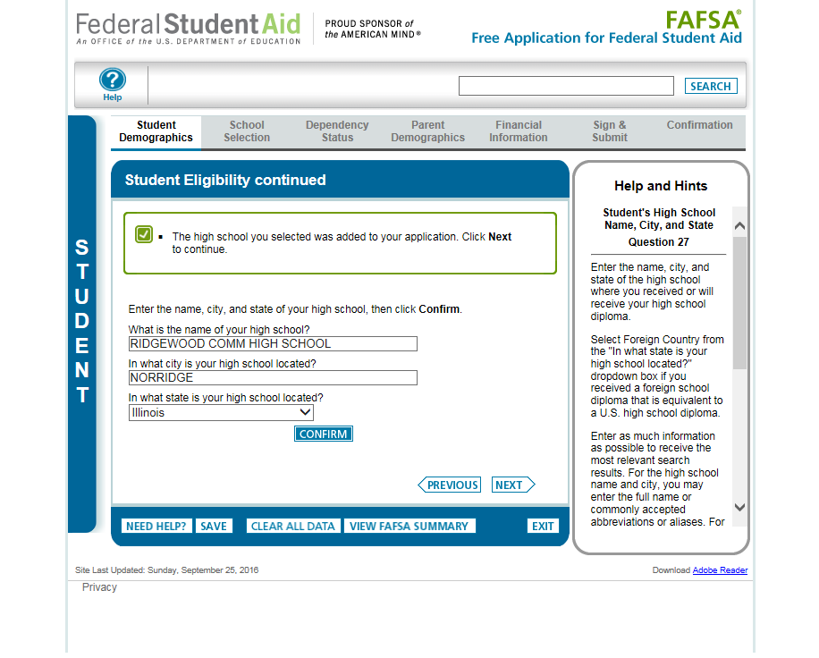
Student Eligibility/High School Search (Independent)
Notes:
2017-18 “Student Eligibility continued” page.

Slide 54
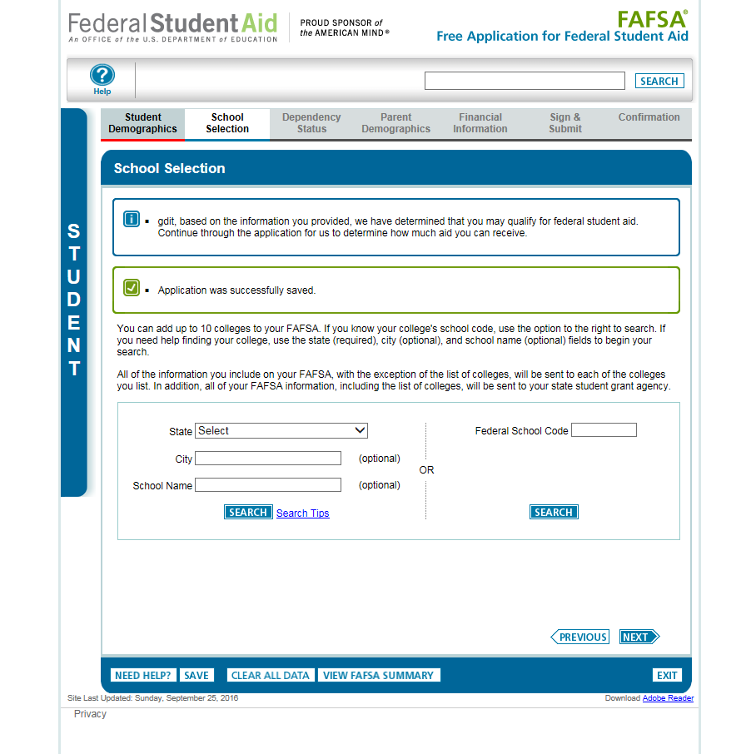
School Selection (Independent)
Notes:
“School Selection” page.

Slide 55
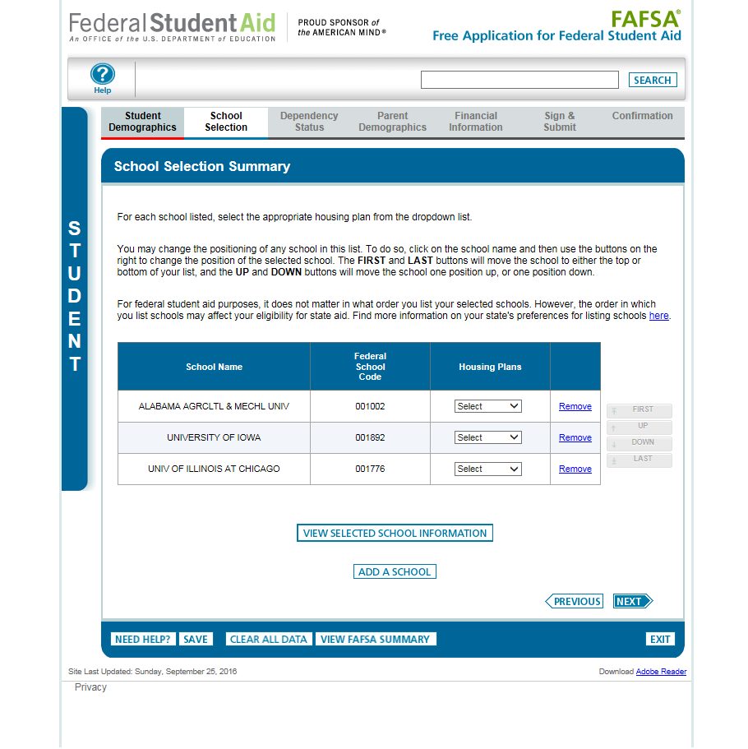
School Selection Summary (Independent)
Notes:
2017-18 “School Selection Summary” page.

Slide 56
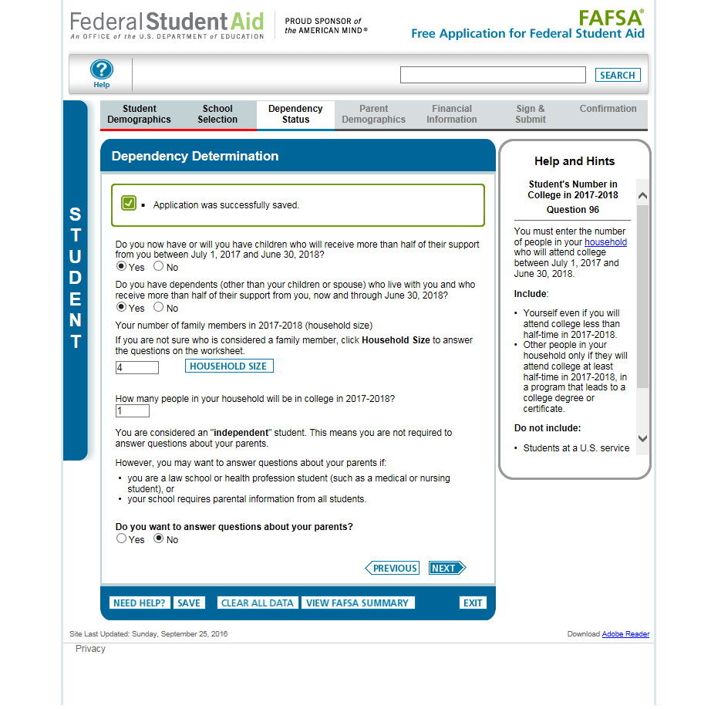
Independent Student, Dependency Determination
Notes:
2017-18 “Dependency Determination” page.

Slide 57
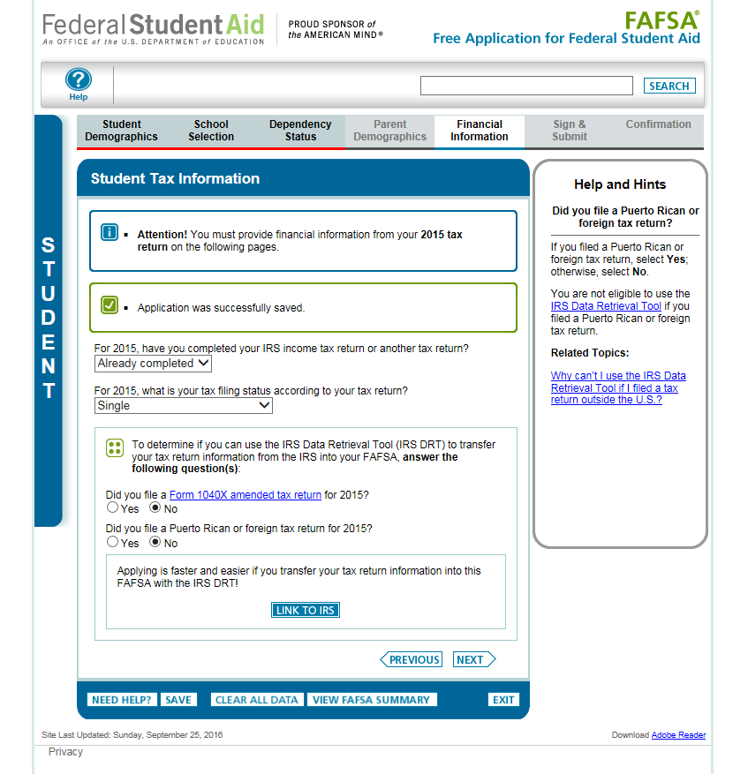
Independent Student, Student Tax Information (continued)
Notes:
2017-18 “Student Tax information” page.
New for 2017-18, the 2015 tax information will be requested instead of the 2016 tax information. To emphasize this change for students and parents, an alert message will display indicating “Attention! You must provide financial information from your 2015 tax return on the following pages.”
Additionally, the IRS DRT section of the application has been revised to make the following changes:
The “Did you file taxes electronically in the last 3 weeks (or by mail in the last 11 weeks)?” question has been removed.
Students will not be requested to provide their FSA ID (if not already provided) on the Student Tax Information page prior to clicking “Link to IRS”
The Amended Tax Return and Foreign Tax Return questions have been revised to include 2015 as part of the question.
The definition of the 1040 X amended tax return can be found by following the link that was added to the question.

Slide 58
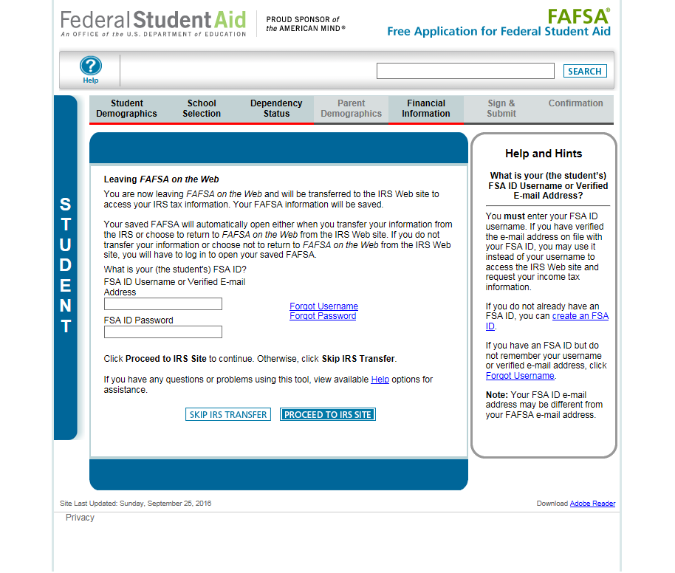
Independent Student, Leaving FOTW
Notes:
2017-18 “Leaving FAFSA on the Web” page, displayed when the student is going to the IRS Web site.
The “Leaving FAFSA on the Web” page has been revised to provide information on how to utilize the IRS DRT and what will occur if they opt to not use the IRS DRT.

Slide 59
Independent Student, IRS DRT (Warning Message)
Notes:
Warning text appears as the 2017-18 IRS Data Retrieval Tool site is displayed.

Slide 60
Independent Student, IRS DRT with user information from FOTW
These fields are pre-filled based on FAFSA responses
Notes:
2017-18 IRS Data Retrieval Tool, page 1, containing user demographic information.
Even though the fields at the top are pre-filled based on FAFSA responses, the first name, last name, date of birth and the filing status can be updated on this page. The Social Security Number cannot be updated.

Slide 61
Independent Student, IRS DRT Submit and Return Functions
Notes:
2017-18 IRS Data Retrieval Tool, page 1, containing user demographic information (continued, updated with user information). The user can click “Submit” to retrieve IRS data, or “Return to FAFSA” to discontinue use of the IRS DRT and return to FOTW.

Slide 62
Independent Student, IRS DRT Transfer Functions
Notes:
2017-18 IRS Data Retrieval Tool, page 2, containing user-specific IRS data.
The user can check the “Transfer My Tax Information…” box and click “Transfer Now” to carry this data back into FOTW.
The user can check the “Do Not Transfer…” box and click “Do Not Transfer” to discontinue use of the IRS DRT and return to FOTW.
The user can click the “Print this page” icon in order to print the data that is displayed on this page.

Slide 63
Independent Student, Student Financial Information Page
Notes:
2017-18 “Student Financial Information” page.

Slide 64
Independent Student, Student Financial Information Page (continued)
Notes:
Top half of the 2017-18 “Student Financial Information continued” page. Bottom half of the page is continued on the next slide.

Slide 65
Independent Student, FOTW Student Financial Information Page
Notes:
This is the bottom half of the 2017-18 “Student Financial Information continued” page.

Slide 66
Independent Student, Sign and Submit
Notes:
This is the 2017-18 “Sign & Submit” page for an independent student.
Since the student entered his/her FSA ID to go to the IRS to transfers data, he/she is not requested to provide his/her FSA ID Username and Password again to sign the application.

Slide 67
Independent Student, Confirmation
Notes:
This is the 2017-18 “Confirmation Page”

Slide 68
My FAFSA® Pages

Slide 69
My FAFSA Page
The My FAFSA® page is a navigation tool for the applicant when accessing the FAFSA on the Web site.
The page provides the following dynamic options and messaging based on the status of the student’s FAFSA:
Start a 2017-18 FAFSA
Complete and submit a FAFSA Renewal
Make FAFSA Corrections
View the Student Aid Report
View Correction History
Provide Missing Signatures
Notes:
You’ve already seen the “Start 2017-18” FAFSA page. On the next slide we’ll show you the “My FAFSA” page when a renewal FAFSA exists.

Slide 70
My FAFSA, Renewals
Notes:
2017-18 “My FAFSA” page.
The Get Started page provides the option to file either of the 2 available cycle’s applications.
This page was revised to provide clarification on which school year the applicant should apply for based on the school year they are planning to attend college.
The applicant can view the status of his/her FSA ID in the FSA ID section of the My FAFSA page.

Slide 71
FOTW My FAFSA page, Renewals
Notes:
2017-18 “My FAFSA” page.
A renewal FAFSA exists when the applicant has a FAFSA with a valid EFC from the previous year. Selecting “FAFSA Renewal” allows the applicant to prefill the current year’s FAFSA with some data from last year’s application.

Slide 72
My FAFSA, Post-Submission Options
Notes:
This slide shows the 2017-18 “My FAFSA” page when an application has been submitted; the applicant has several choices. They can make a correction by choosing “Make FAFSA Corrections,” or they can view and print his/her Student Aid Report (SAR) in one of two formats by selecting “View or Print your Student Aid Report (SAR).”
If he/she chooses “Make FAFSA Corrections,” they will be taken to a page asking them for his/her FSA ID Username, FSA ID Password and Save Key.
Choosing “View or Print your Student Aid Report” will take the applicant to a page asking for his/her FSA ID Username, FSA ID password. From there they will be able to view his/her SAR.

Slide 73
My FAFSA, Provide Signatures
Notes:
2017-18 “My FAFSA” page, when signatures are missing on a submitted FAFSA.
When the applicant, or his/her parent (in the case of a dependent applicant) clicks on “Provide Signatures,” they are taken to the “Provide Signatures” page (see next slide).

Slide 74
Provide Signature(s), Dependent Student
Notes:
2017-18 “Provide Signature(s)” page for a dependent student.
Here the parent (of a dependent applicant) or the applicant (student) can provide his/her signature(s) electronically by clicking on “Sign Electronically With My FSA ID (Fastest).”

Slide 75
Provide Signature(s), Dependent Student (continued)
Notes:
2017-18 “Provide Signature(s)” page for a dependent student, continued.

Slide 76
Sign with an FSA ID, Dependent
Notes:
2017-18 “Sign With an FSA ID” page for a dependent student.
If the applicant also chooses to sign electronically, both are taken to the “Sign With an FSA ID” page. The parent’s data is carried forward from the “Provide Signatures” page. The parent must enter his/her FSA ID Username, FSA ID password and actively agree to the Certification Statement.
The applicant must do the same. The signatures can then be submitted.

Slide 77
Confirmation Page, no EFC
Notes:
The 2017-18 “Confirmation Page” for the applicant and parent signatures that have just been submitted; the message on the “Confirmation Page” clearly states that “We cannot calculate an Expected Family Contribution (EFC) until your application is processed.”

Slide 78
My FAFSA, Application Processing
Notes:
The user can click “Exit” from the “Confirmation Page,” and will be taken back to the 2017-18 “My FAFSA” page where the “Current Application Status” has changed from “Provide Signatures” to “Processing.” Once the signatures are applied to the application (usually within 24-72 hours), the applicant will be able to view the processed SAR and make any necessary corrections.

Slide 79
My FAFSA, Signatures Applied
Notes:
View of the 2017-18 “My FAFSA” page after the missing signatures have been applied, and the FAFSA has been processed.

Slide 80
Auto-Zero EFC (skipping the remaining financial questions)

Slide 81
Parent Financial Information, Auto Zero EFC
Notes:
2017-18 “Parent Financial Information” page for a dependent student who qualifies for an Auto-Zero EFC.
When the applicant qualifies for an Auto-Zero EFC, they may be given the option to skip the remaining financial questions on the FAFSA (depending on the applicant’s state of legal residence). If the applicant answers “Yes” to the “Skipping” question, they skip the remaining financial questions, and are taken directly to the “Sign and Submit” page.
The example in this screenshot displays the “Parent Financial Information” page for a dependent applicant, where the “Skipping” question is displayed. In this example, the parent has chosen to skip the remaining financial questions. The remaining financial questions will be skipped for the parent, and all financial questions will be skipped for the applicant.

Slide 82
Special Circumstances

Slide 83
Dependency Status, Unable to Provide Parent Information
Notes:
2017-18 “Dependency Status Results” page.
If the dependent applicant is unable to provide parental data on the FAFSA, they should select “I am unable to provide parental information.” The applicant should then click on “Next”

Slide 84
Special Circumstances Page
Notes:
2017-18 “Special Circumstances” page.
The applicant will then be taken to the “Special Circumstances” page, where they can either:
Correct his/her response from the previous page and be given the opportunity to provide parental information,
Select the response “I have a special circumstance…” or,
Select a response stating that they do not have a special circumstance, but are unable to provide parental information (and will be eligible for only an unsubsidized loan).
In this example the applicant has selected “I have a special circumstance and I am unable to provide parental information.” The applicant can then click “Next”

Slide 85
Unable to Provide Parental Information Page
Notes:
The applicant is taken to the 2017-18 “Unable to Provide Parental Information” page, and has the opportunity to either provide parental information, or continue on the “Unable to Provide Parental Information” path. In this example, the applicant continues down the “Unable to provide parental information” path, and then clicks the “Next” button. This path allows the applicant to skip the parental information questions, and go to the student financial information questions.

Slide 86
Special Circumstance – Unsubsidized Loan Only

Slide 87
Dependency Status Results, No Parent Information
Notes:
2017-18 “Dependency Status Results” page.
If the applicant does not have a special circumstance, but is unable to provide parental information, they should click on, “I am unable to provide parental information” and click the “Next” button.

Slide 88
Special Circumstances, Unable to Provide Parental Information
Notes:
The applicant is taken to the 2017-18 “Special Circumstances” page, selects, “I do not have a special circumstance but I am unable to provide parental information”, and clicks the “Next” button.

Slide 89
Unsubsidized Loan Only
Notes:
The applicant is taken to the 2017-18 “Unsubsidized Loan Only” page. This page contains information about submitting the application without parental information, and informs the applicant that they will be eligible for an unsubsidized loan only.
The applicant is given the opportunity to provide parental information. If they decide not to provide parental information, they can click the “Next” button.

Slide 90
Unable to Provide Parental Information Page, Unsubsidized Loan
Notes:
The applicant is taken to the 2017-18 “Unable to Provide Parental Information” page.
The applicant is given a final opportunity to provide parental information. If they choose not to provide parental information, they can click the “Next” button. The applicant will be allowed to skip the parental information pages and will be taken to the student financial information pages.

Slide 91
Homeless Circumstance

Slide 92
FOTW Dependency Determination Page
Notes:
2017-18 “Dependency Determination” page.
The dependency questions at the bottom of the Dependency Determination page are the questions that will determine if the applicant will see the Homeless Circumstances questions.

Slide 93
Homeless Circumstances
Notes:
The Homeless or at Risk of Being Homeless page has been revised to provide definitions and examples of homeless circumstances.

Slide 94
Homeless Circumstances, Unable to Provide Parental Information
Notes:
The applicant is then taken to the 2017-18 “Unable to Provide Parental Information” page, where they will be able to proceed after selecting “I am unable to provide parental information…”
The applicant should click the “Next” button; they will then skip the parental information pages and go directly to the student financial information pages.

Slide 95
Additional Resources

Slide 96
Supporting Resources and Information
Notes:
At the top of the 2017-18 FAFSA on the Web home page:
Link to the StudentAid.gov web site
Link to the Help Page (shown on the next slide)
The red arrows on this page show the resources on the FAFSA on the Web home page. These include:
Link to College Scorecard
Link to the State and Federal Deadlines
Link to the Federal School Code search (helps student find his/her school codes)
Link to the FAFSA Filing Options.
The PDF FAFSAs for 2017-18 and 2016-17 are available on this page.
Link to FAFSA4caster
Announcements

Slide 97
FAFSA Help
Notes:
This is the 2017-18 FAFSA “Help” page on FAFSA on the Web. In addition to the categories of help on this page, a Trending Questions section is available for students to view the most current trending questions and applicable help topics. The Trending Questions section on this page is updated throughout the year to reflect questions the Federal Student Aid Information Center (FSAIC) receives from applicants.

Slide 98
Student Aid Deadlines
Notes:
The 2017-18 “Student Aid Deadlines” page on FAFSA on the Web dynamically displays the federal, state and college deadlines for each state. A listing of the state deadlines is available in PDF format.
Note: The 2016-2017 federal corrections deadline was revised to 9/9/17.

Slide 99
2017-18 Web Demonstration Site
FAFSA on the Web and FAA Access to CPS Online Web Demonstration sites will be available on September 25, 2016
To access the sites, go to http://fafsademo.test.ed.gov
Enter:
User Name: eddemo
Password: fafsatest

Slide 100
Thank you for previewing the 2017-18 FAFSA on the Web site
Click the button below to view this presentation again.
Click this button to end this presentation.

