Slide 1
Dual Enrollment

Slide 2
Dual Enrollment is a 2 for 1

Slide 3
Advantages
Provides an early start on college courses
Students have flexible scheduling opportunities because courses can be taken anytime.
Saves money because college tuition and expenses are fully or mostly paid.

Slide 4
Disadvantages
Courses may or may not transfer to the college
Colleges may prefer AP courses over dual enrollment courses
Transportation must be provided by the student/parent

Slide 5
Who is eligible?
Be a high school student (mostly 11th and 12th)
Be enrolled in an eligible university or technical college
Meet college’s admission requirements
Qualifying GPA in core curriculum
Qualiying entrance exam scores
Misc requirements
Meet local system requirements.
Be on track to graduate and maintain satisfactory academic progress towards meeting high school graduation requirements.

Slide 6
About Dual Enrollment
Cost:
GA Student Finance Commission (GSFC) pays for up to 15 hours/semester
Hours do not count against the cap for HOPE
Student pays all costs not covered.
Interested students should
take the SAT or ACT or Compass before you apply
apply to the college by the deadline
Requires students to be responsible, dependable and have good time management skills.

Slide 7
Schools most commonly attended by BHS students:
University of North GA *
Georgia Gwinnett College *
Lanier Technical College *
Gwinnett Technical College**
* Student must be an 11th or 12th grader.
** Student must be a 9th, 10th, 11th, or 12th grader.

Slide 8
Application Process 6 Steps:
STEP 1: Take the SAT or ACT or Compass/Accuplacer before you apply to the college. (Be sure to sign up for the testing organization to send your scores to the college.)
STEP 2: Once scores are received and student’s scores meet the college requirements, set up a parent and student meeting with a counselor.
Cont. on next slide

Slide 9
STEP 3: Apply to the college (refer to college website for deadline)
Use your correct SSN and full legal name
Apply as a Dual Enroll student
Send official test scores (ACT/SAT-sent directly from test organization)
Send AP scores (if applicable-sent in MAY directly from collegeboard)
Request HS Transcript: Submit all together to Ms. Collins:
request to send an Official Transcript Form (form available on the BHS Guidance Website or Career Center)
Completed dual enrollment Student Participation Agreement Form (form completed with counselor)
copy of Verification of Lawful Presence (ID) (choose one)
copy of Certificate of Immunizations
Cont. on next slide

Slide 10
If accepted to the DE program: (a letter from the college)
STEP 4: Set up meeting with College Admissions Advisor to discuss paperwork and register for class.
If schedule questions, email BHS counselor to see when BHS courses are offered.
STEP 5: Complete the online DE Application to apply for the payment of the program
Must be completed EVERY SEMESTER
Located on GAFutures – Dual Enrollment
STEP 6: Give a copy of your college schedule to BHS counselor (ASAP – preferably before each semester begins)
Must be completed EVERY SEMESTER
RESOURCES:
www.GAFutures.org

Slide 11
Courses
Students are required to take classes on the Approved dual course list from GADOE:
www.gsfc.org/secure/dsp_accel_course_listings.cfm
Cont. on next slide

Slide 12
Full Time College Status vs Part Time College Status
Part time status is a minimum of 6 classes between BHS & college.
Full time status is a minimum of 12 course hours and a maximum of 15 hours all taken on the college campus.
A 3 hr college course (1 sem) = 1 credit @ BHS (2 sem)
ex: student is required to take only 1 sem of English at the college to equal 2 sem of English @ BHS.
Cont. on next slide

Slide 13
Powerschool Class Registration: Dual Enroll - English, Math, Environmental Science, Economics, or if full time you need to choose the Elective option

Slide 14
Grading
Colleges use letter grades A=95 B=85 C=75 D=70
If a course requires an EOC, the student is required to take the exam.
EOC not required for Am Lit, US History, Economics, Phys Sci
The exam grade will be calculated as 20% of the grade as listed above.
Weighted GPA
+10 points is added to dual credit courses for calculating academic weighted percent and HOPE GPA
Elective credits do not count in GPA for Class Rank, Honor Roll (Duplicated credits, Fine Arts, PE, Sociology, etc)

Slide 15
Senior Required Courses:
English
Advanced Composition
Math
Algebra * Statistics
Science
Economics
PreCalculus * Calculus
American Government
Environmental Sci * Forensics
Human Anatomy

Slide 16
Part Time MOWR Sample Schedule
Minimum of 6 classes taken per semester
Classes at college are usually scheduled for
Mon, Wed, & Fri -1 hr/day OR Tues & Thurs / Mon & Wed - 1½ hr/day
Sem 1
English in am @ college
3rd – Dance
4th – Musical Theater
5th – AP Biology
6th – Government
7th – Chorus
Sem 2
Math at College
3rd – Dance
4th – Musical Theater
5th – AP Biology
6th – Economics
7th – Chorus
Sem 1
1st – AP Psychology
2nd – AP Literature
3rd – Education Intern
Math @ college
Government @ college
Music Appr @ college
Sem 2
1st – AP Psychology
2nd – AP Literature
3rd – Education Intern
Science w/ Lab @ college
Economics @ college
Sociology @ college

Slide 17
Full Time MOWR Sample Schedule
Minimum of 4 classes (12 hours) per semester required
All classes taken on the college campus
Sem 1
English (required)
Government (required)
Environ Sci w/ Lab (required)
Sociology (elective)
Sem 2
Math (required)
Economics (required)
English (elective)
Art History (elective)
Sem 1
Math (required)
Economics (required)
Government (required)
Speech (elective)
Sem 2
English (required)
Environ Sci w/ Lab (required)
Psychology (BHS offers)
Music Apprec (elective)

Slide 18
Dual Enrollment

Slide 19
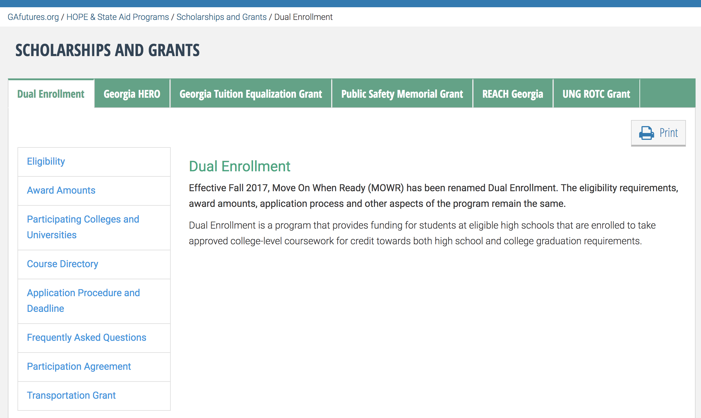
To view the Course Directory to see what courses are available for a student to take
at a particular college click on the link below and follow the following slides
Course Directory

Slide 20
Course Directory

Slide 21
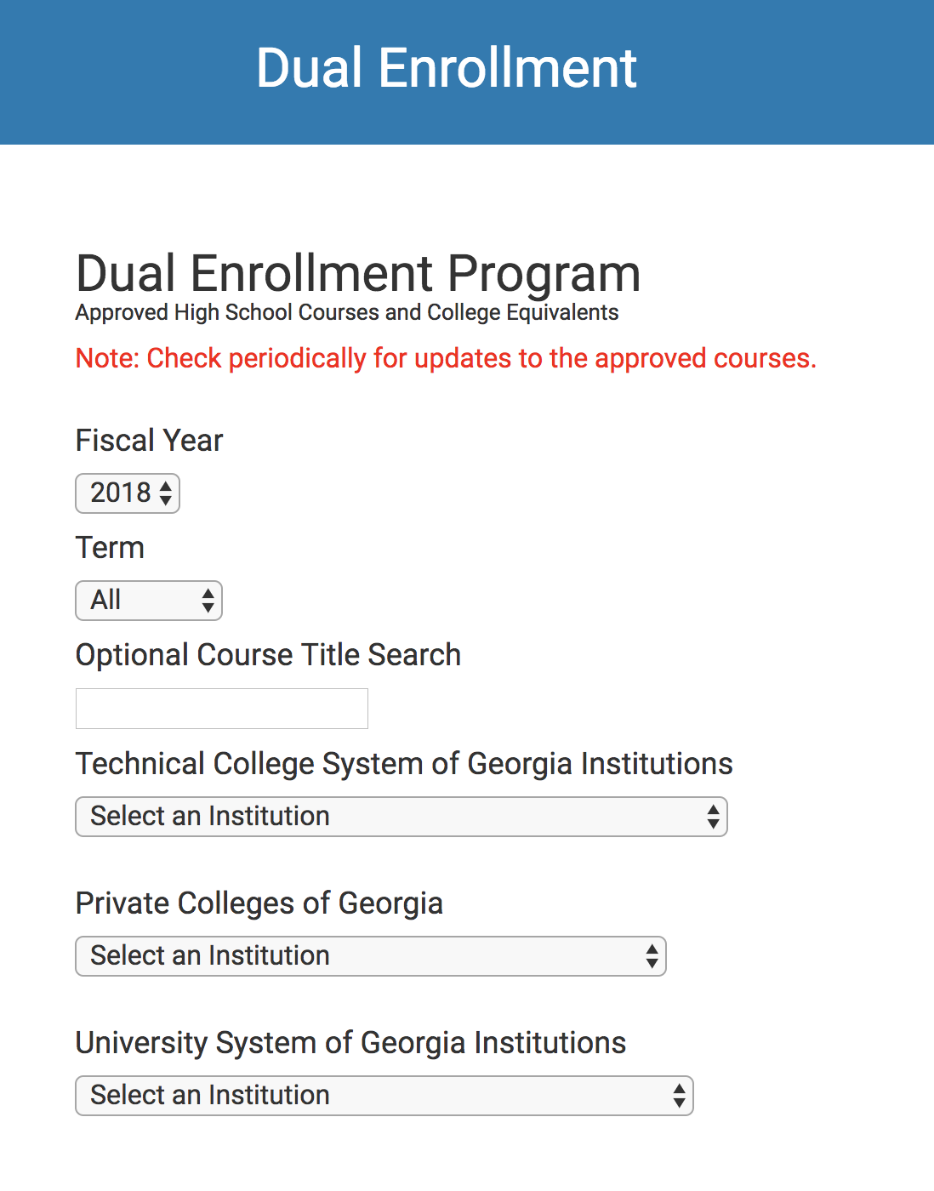
To search for a college course that is approved for DE and to check the correlated high school course, click on the drop down menus.
Course numbers CAN NOT be the same number that the student has already earned credit for.
See a counselor for more information
2019 or 2020
Fall or Spring
Subject (optional)
For Technical College
For Public College

Slide 22
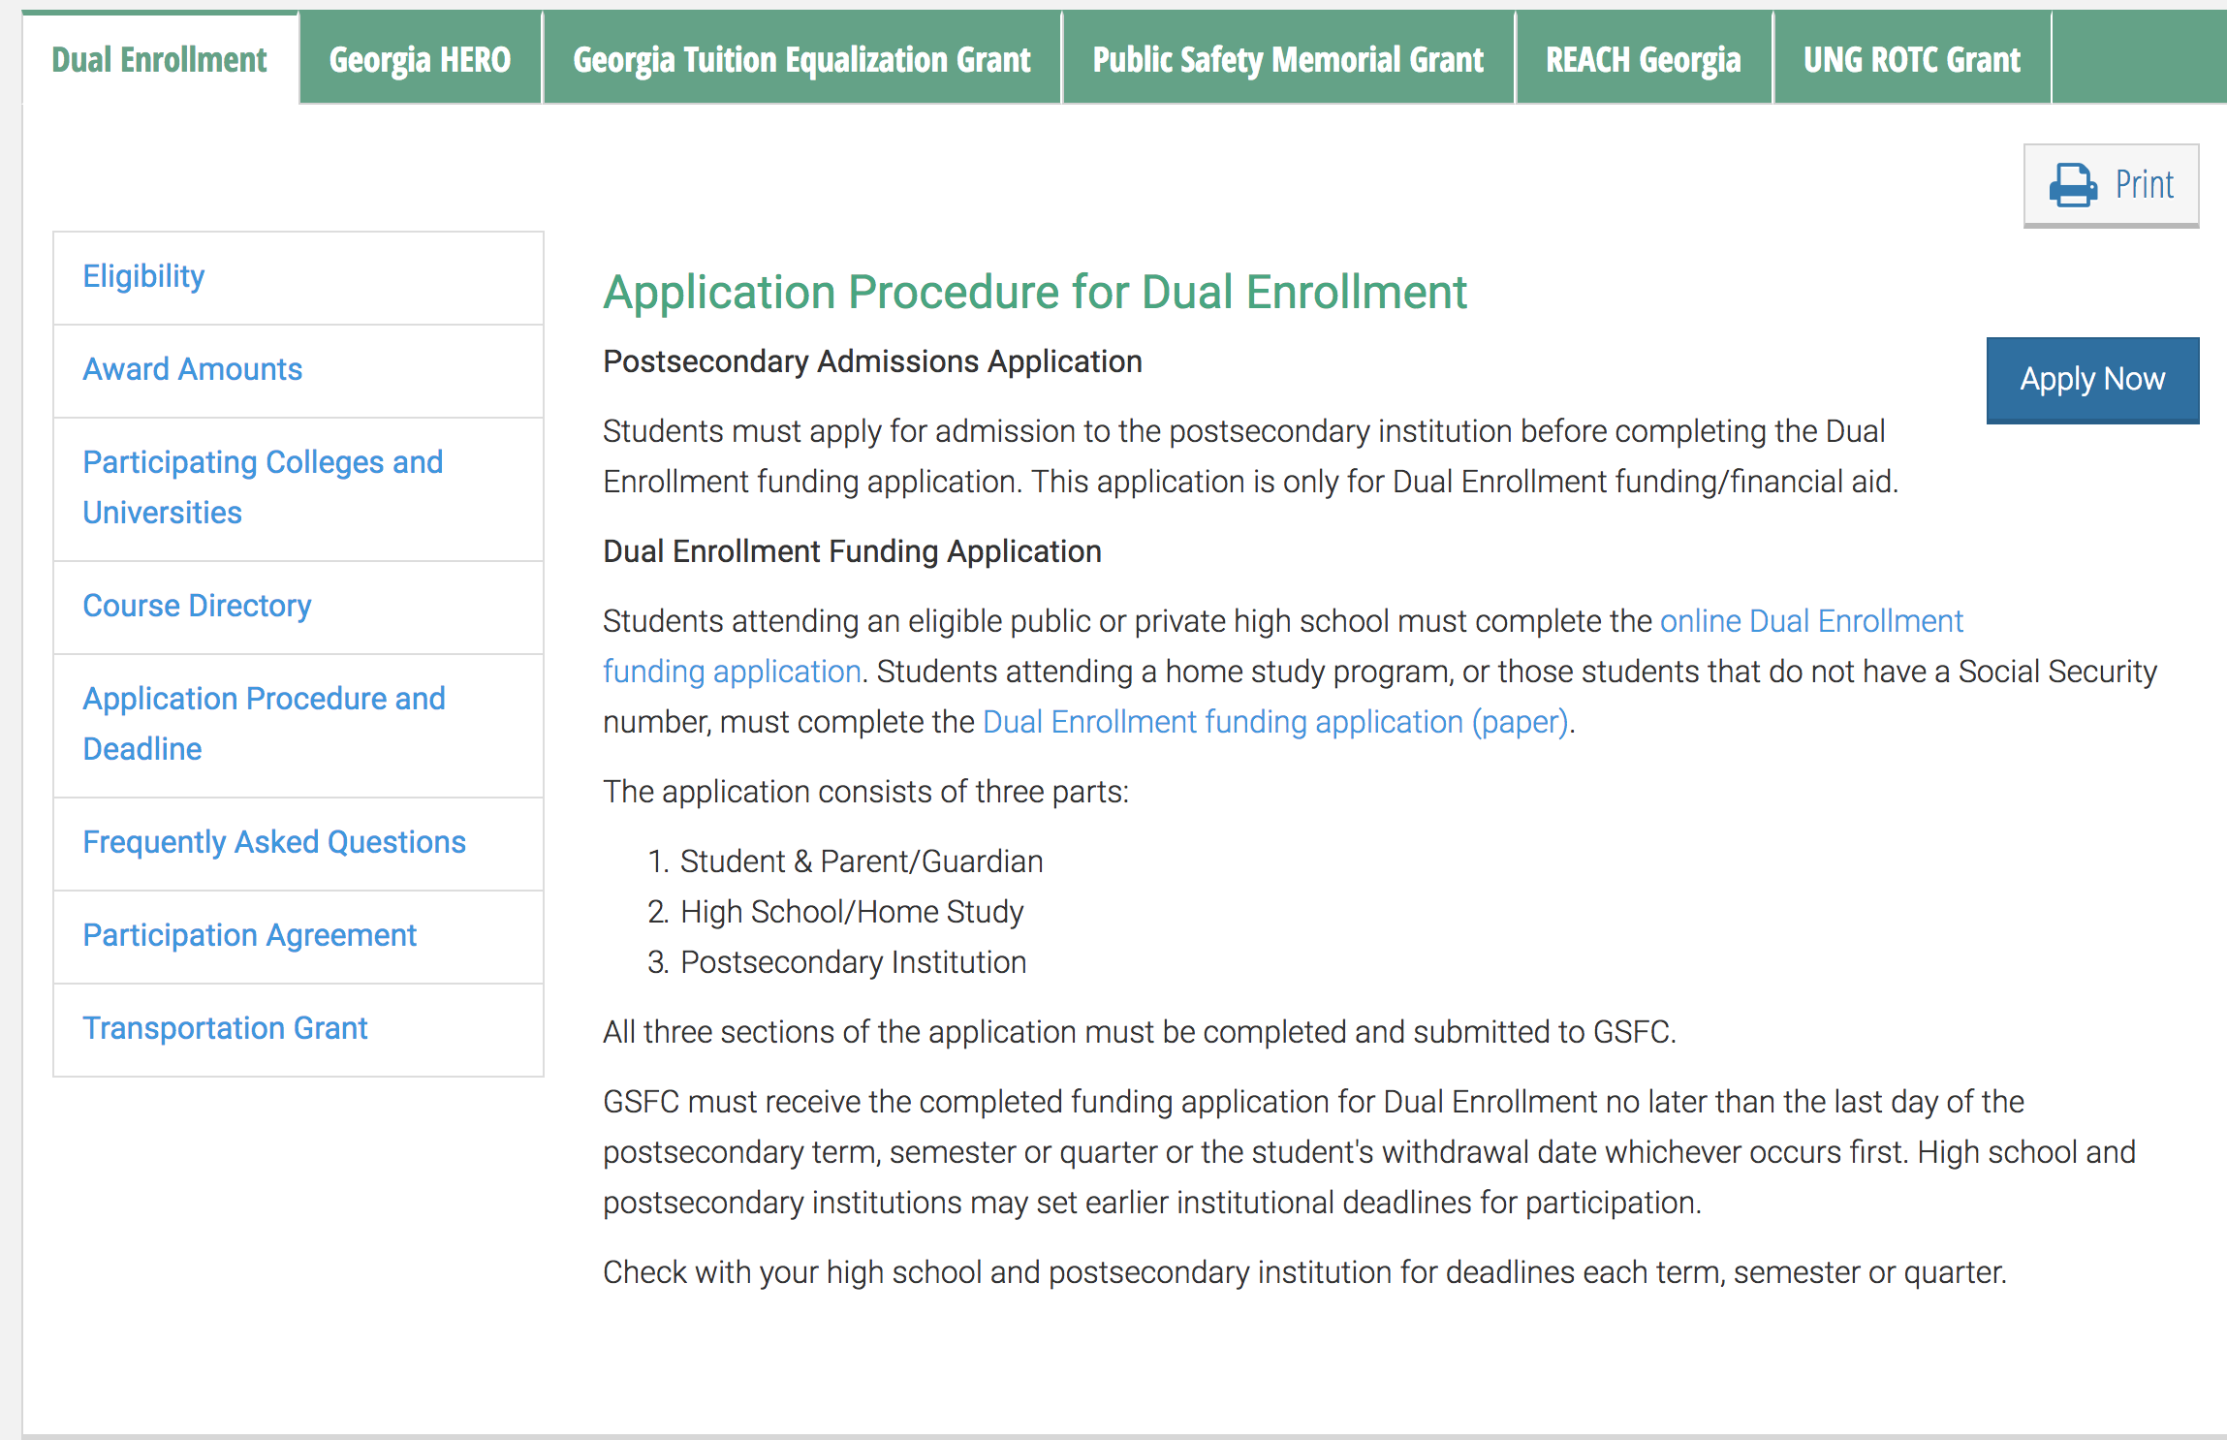
Online Dual Enrollment Funding Application

Slide 23
Resources:
GA Futures: www.GAfutures.org
BHS Webpage → About →Counseling → Dual Enrollment

