Slide 1
The FAF$A Process
FREE
Application for Federal
Student Aid

Slide 2
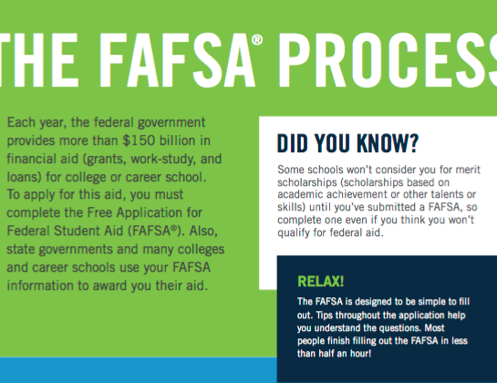
THE FAFSA PROCESS

Slide 3
.
.

Slide 5
